Slide 1
This Week in PE Class!
Learning How
to Tie Our Shoes

Slide 2
Watch the Video For Directions and Then Click Below to Go to the Next Slide

Slide 3
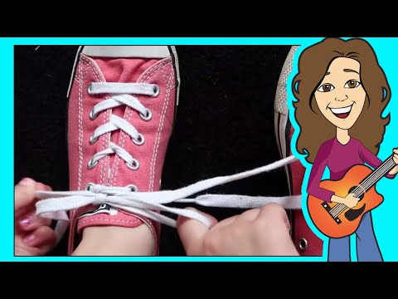
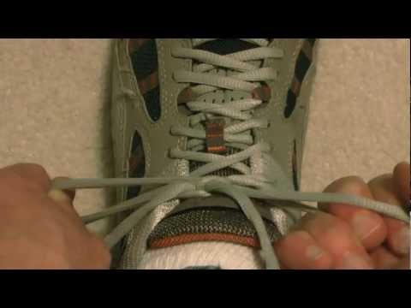
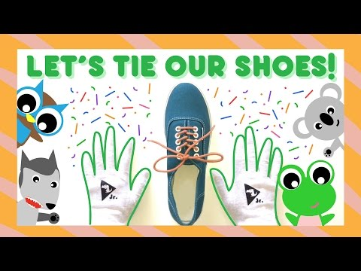
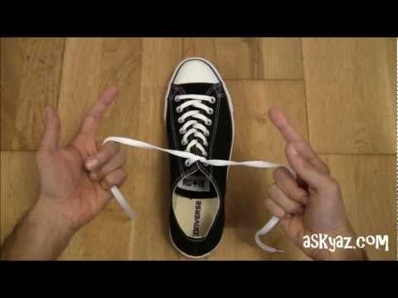
Directions: Please watch the videos below and choose what you think will be the BEST way for you to learn to tie your shoes.
Practice tying your shoes at least 4 times.
Repeat daily until you can do it with no mistakes.
TECHNIQUE #1:
Traditional Method
TECHNIQUE #2:
Bunny Ears Method
TECHNIQUE #3:
Knot and a Half
TECHNIQUE #4:
Backwards Knot
TECHNIQUE #5:
1 Second Knot

