Slide 2
Your teacher:
Welcome to grade 4FI. My name is Mylène Comeau and I’m thrilled to be your child's teacher this year.
Contact information:
Mylene.comeau@nbed.nb.ca

Slide 3
Communication will be an essential tool for us. I consider myself to be a very approachable teacher and it is my hope to develop an open, trusting relationship with you this year. I encourage you to speak with me should you have any questions, concerns, or insights to share throughout the school year.
My preference of communication is via email. You will receive a weekly update by email informing you of concepts covered in class, important dates, etc. If you did not receive an email, please send me an email and I will add you to the group ☺
mylene.comeau@nbed.nb.ca

Slide 4
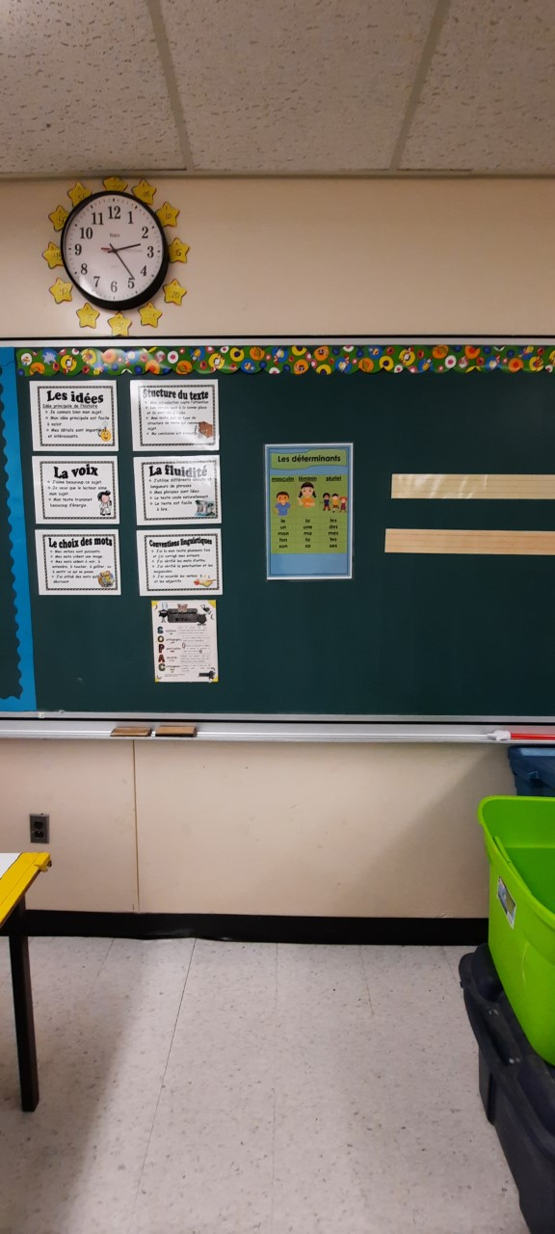
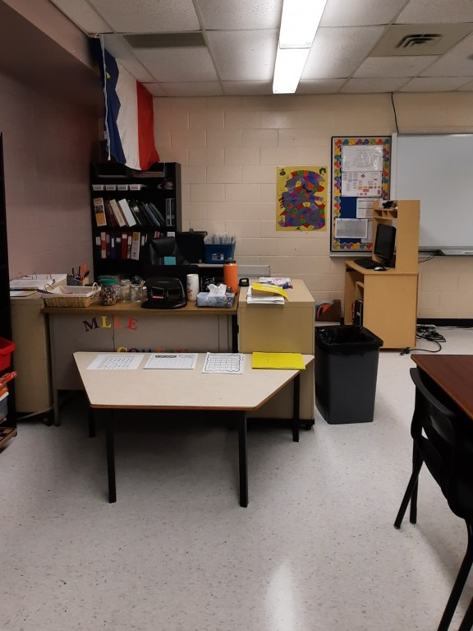
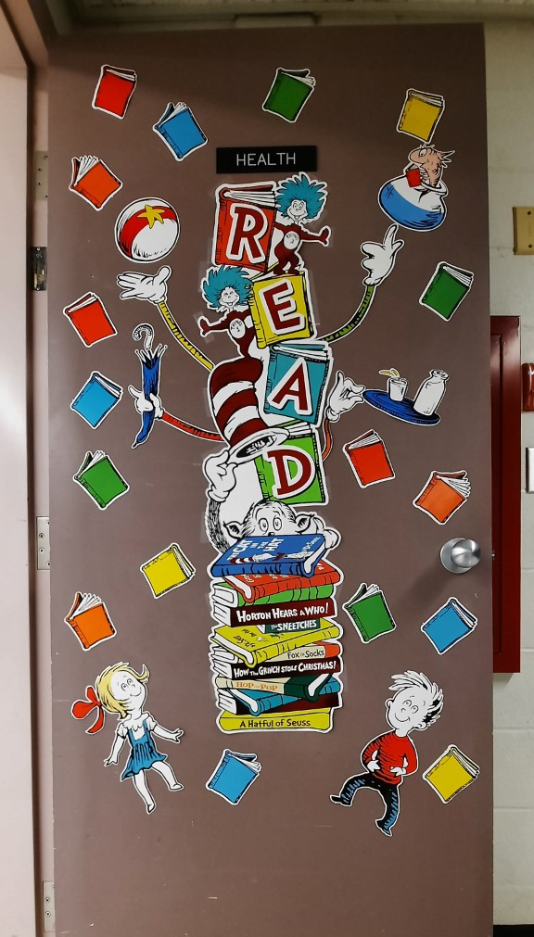
Notre classe

Slide 5
 | Lundi | Mardi | Mercredi | Jeudi | Vendredi
8h20-8h30 | Français Lec.Guidée | Français Lec.Guidée | Français Lec.Guidée | Français Lec.Guidée | Français Lec.Guidée
8h30-9h40
9h40-9h55 | RÉCRÉATION
9h55-10h10 | COLLATION
10h10-10h40 | Français | Français | Français | Français | Français
10h40-11h40 | Math | Math | Math | Math | Math
11h40-12h40 | RÉCRÉATION / DINER
12H40-1H15 | Musique | Enquêtes | Éducation physique | Éducation physique | Musique
1h15-1h50 | Enquêtes Bibliothèque |  | Anglais | Enquêtes | Art / Enquêtes
1h50-2h25 |  | Éducation physique |  | Anglais
2h25-3h00 |  | Enquêtes
3h00-3h10 | AUTOBUS
A paper copy was also sent with your child!

Slide 6
-Speak French in class
-Be kind
-Be respectful
-Be ready to learn
-Be responsible
-Be helpful
-Be a good listener

Slide 7
A friendly reminder that there is no microwave.

Slide 8
French and English reading every night
(15 minutes each)

Slide 9
Practicing mental math skills is strongly encouraged ☺

Slide 10
Fun website to try at home
Here’s a few good websites to explore:
Math Games | Math Playground | Make Learning Fun
French Reading: https://app.boukili.ca/
Click on the link
Go to “J’ai un code classe”. The class code is ncfwp2.
Click on child's name and enjoy reading!

Slide 11
A home learning duotang went home with your child in the event that school would close.

Slide 12
You are part of your child’s educational team. Encourage your child to discuss school activities with you. Talk positively about school. Ask your child specific questions about what they did each day. It’s important for children to see that you value school and education. Together we can create the best possible learning environment for your child.

Slide 13
I am enthusiastic about working together.
Looking forward to an awesome year,
Mlle Comeau
mylene.comeau@nbed.nb.ca

Slide 14
Thank you!!
Merci!!
Wela’lin

