Slide 2
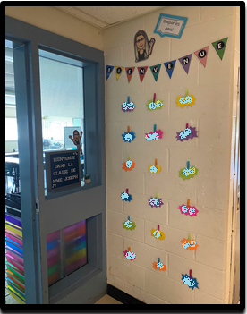
Welcome to Grade 3 French Immersion! My name is Joline Joseph and I’m very excited to be your child’s teacher this year!
welcome
joline.joseph@nbed.nb.ca
Contact info
Mme joseph

Slide 3
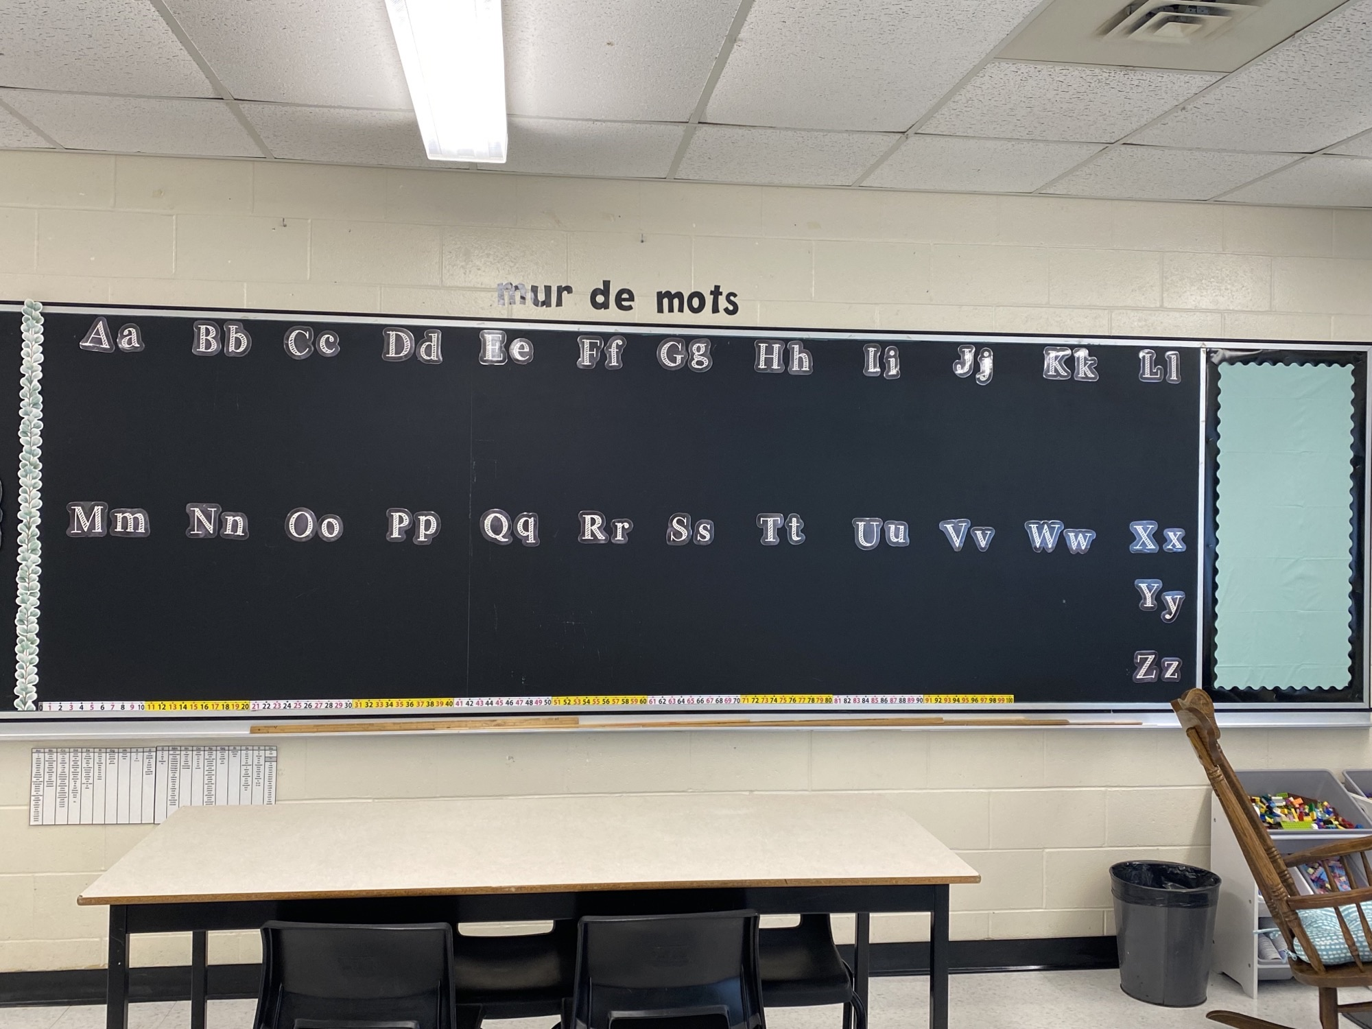
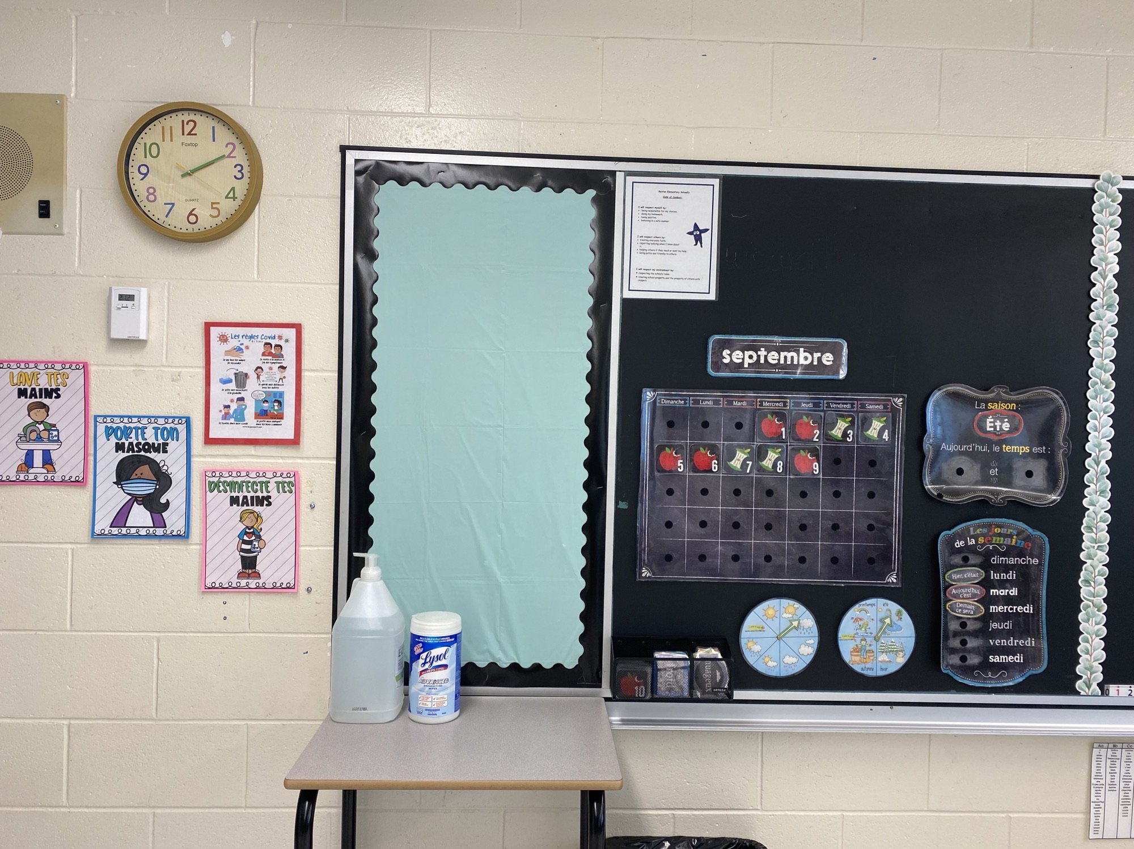
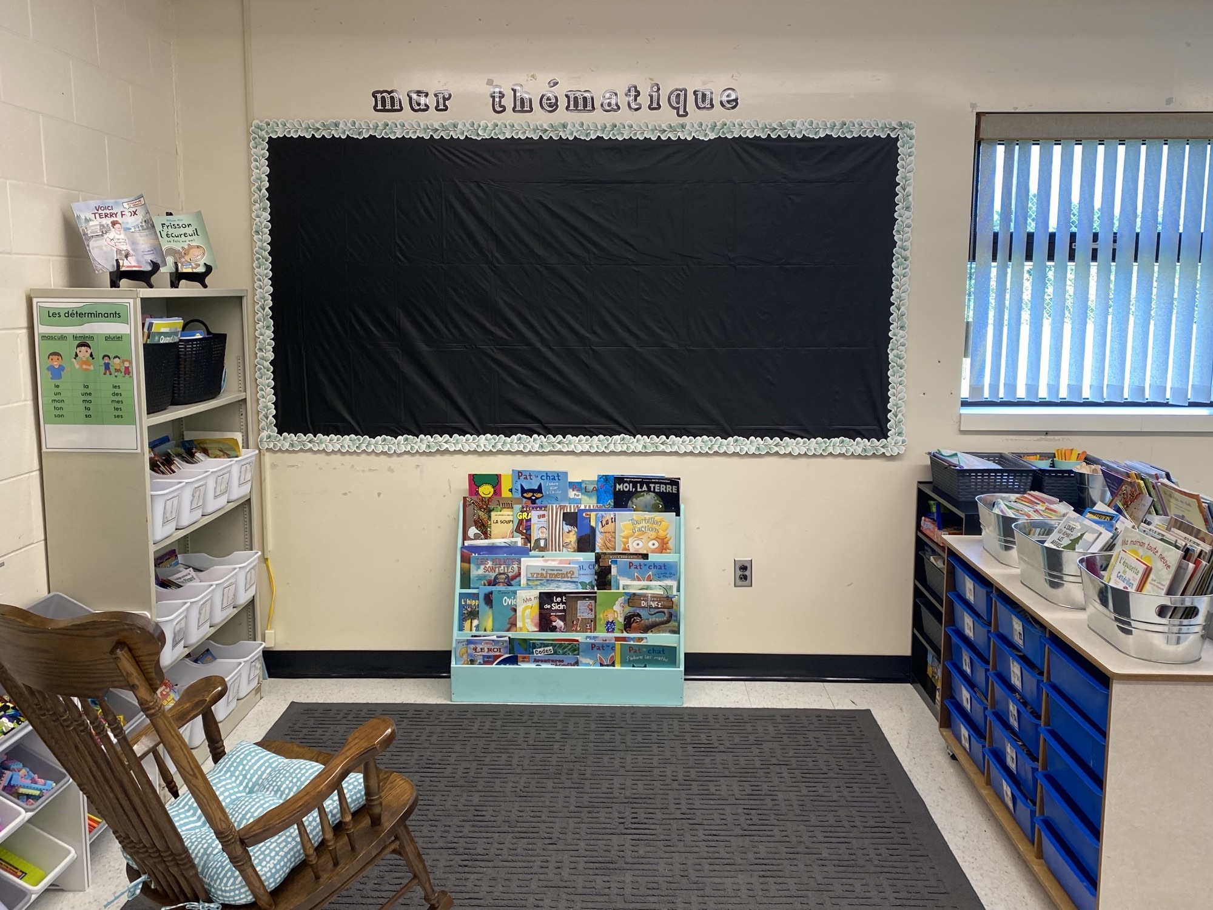
Our classroom

Slide 4
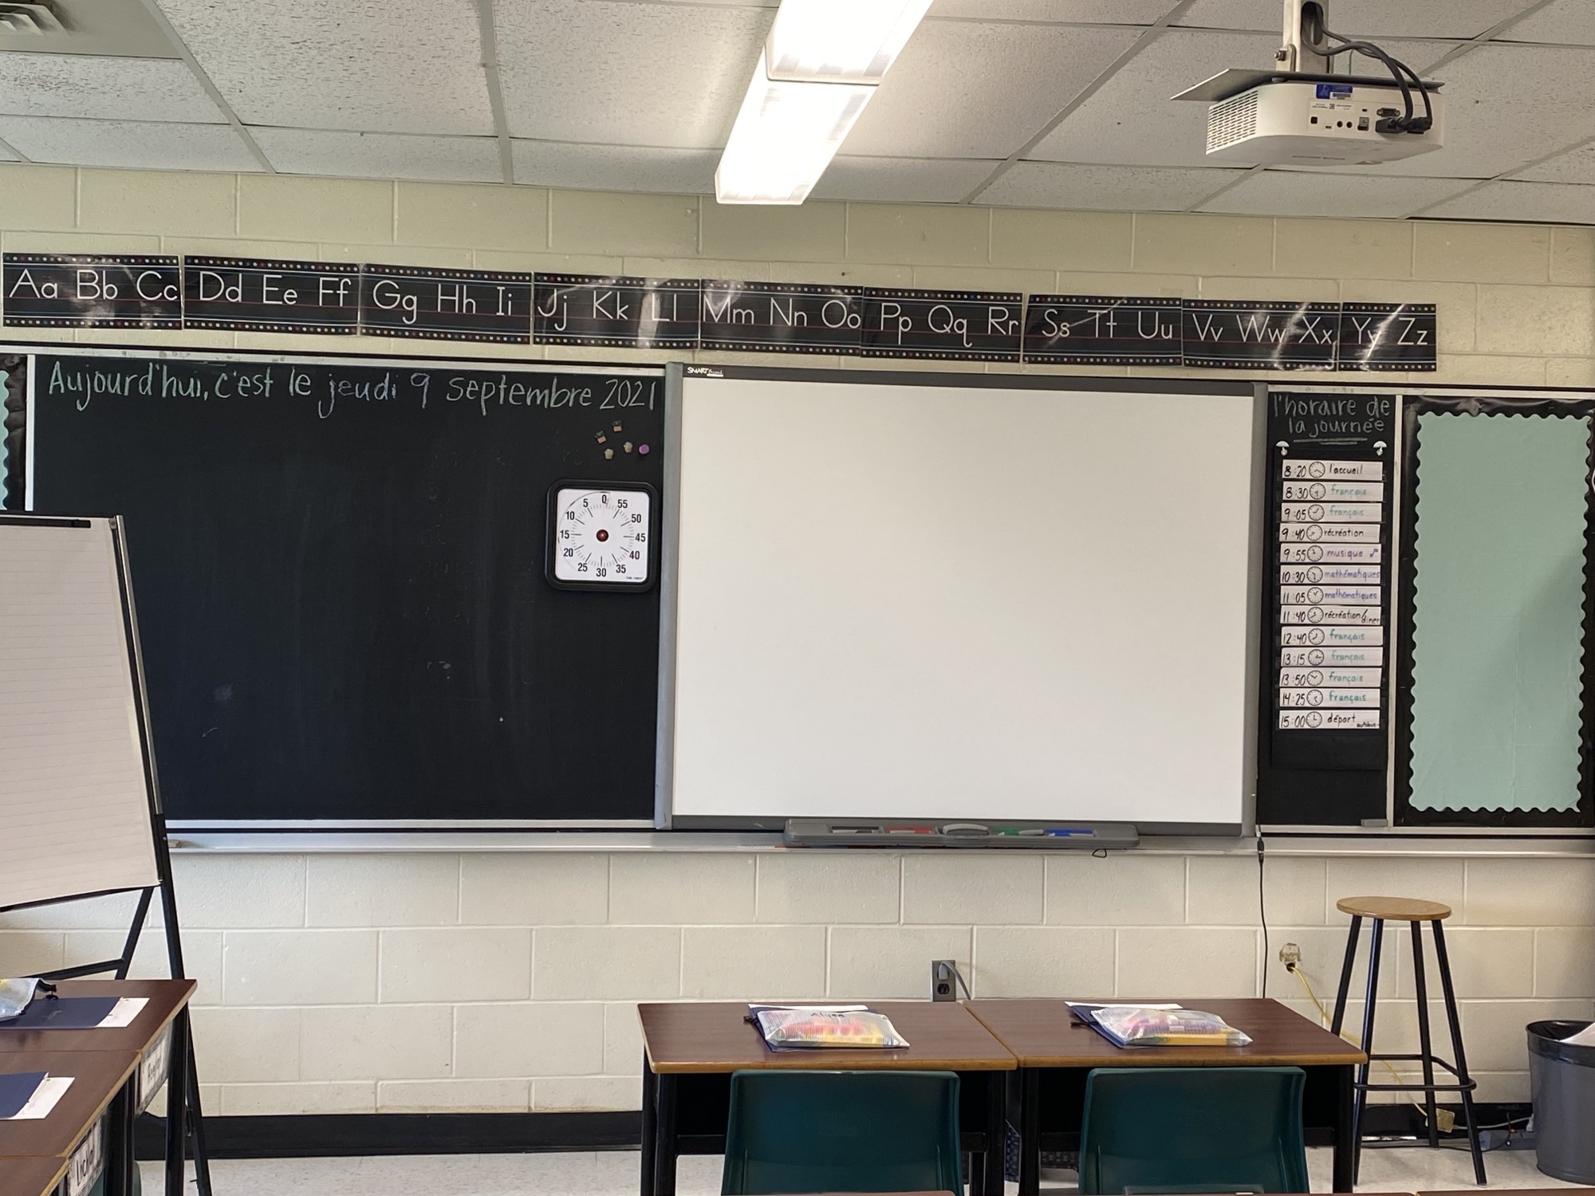
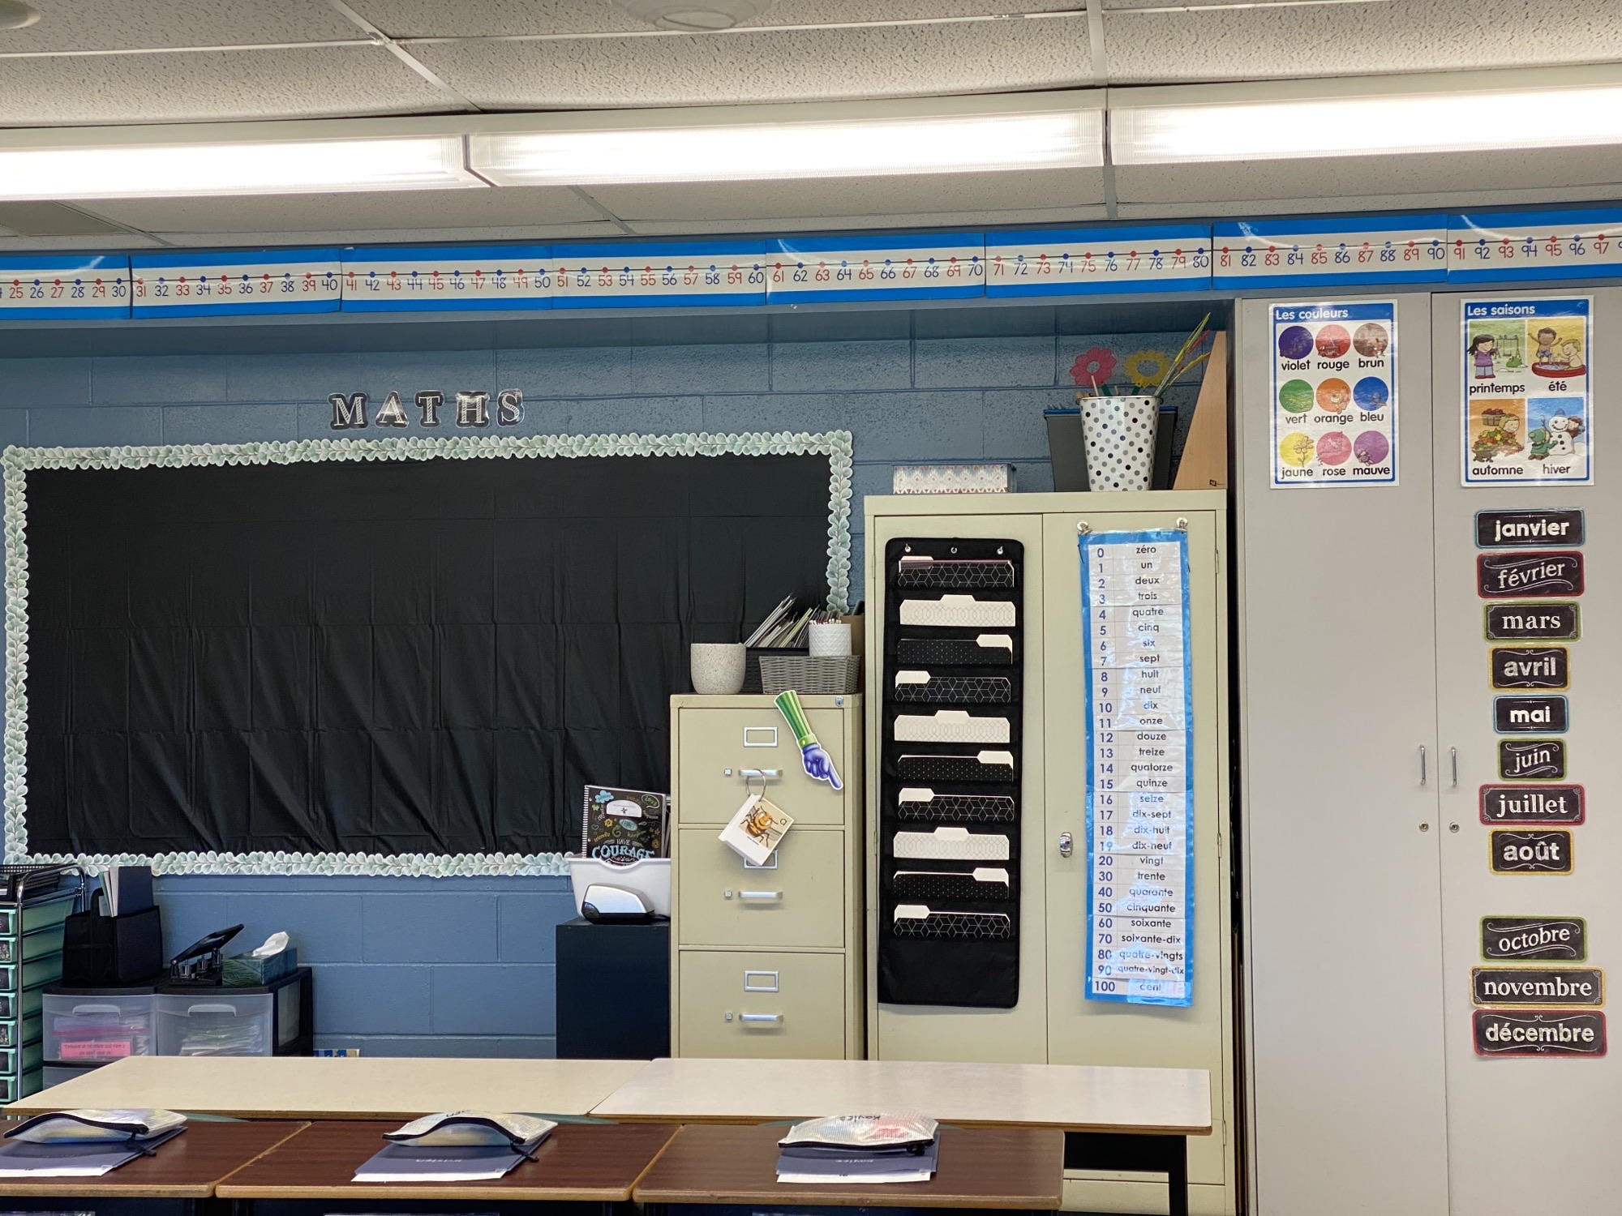
Our classroom

Slide 5
Class expectations
Notes:
I speak French at all times.
I walk in the classroom.
I respect my classmate’s things.
I am calm in class.
I lift my hand up to speak and I listen to the others.
I respect the other students in my classroom. ** We’ve discussed what respecting others looks like in class multiple times. **

Slide 6
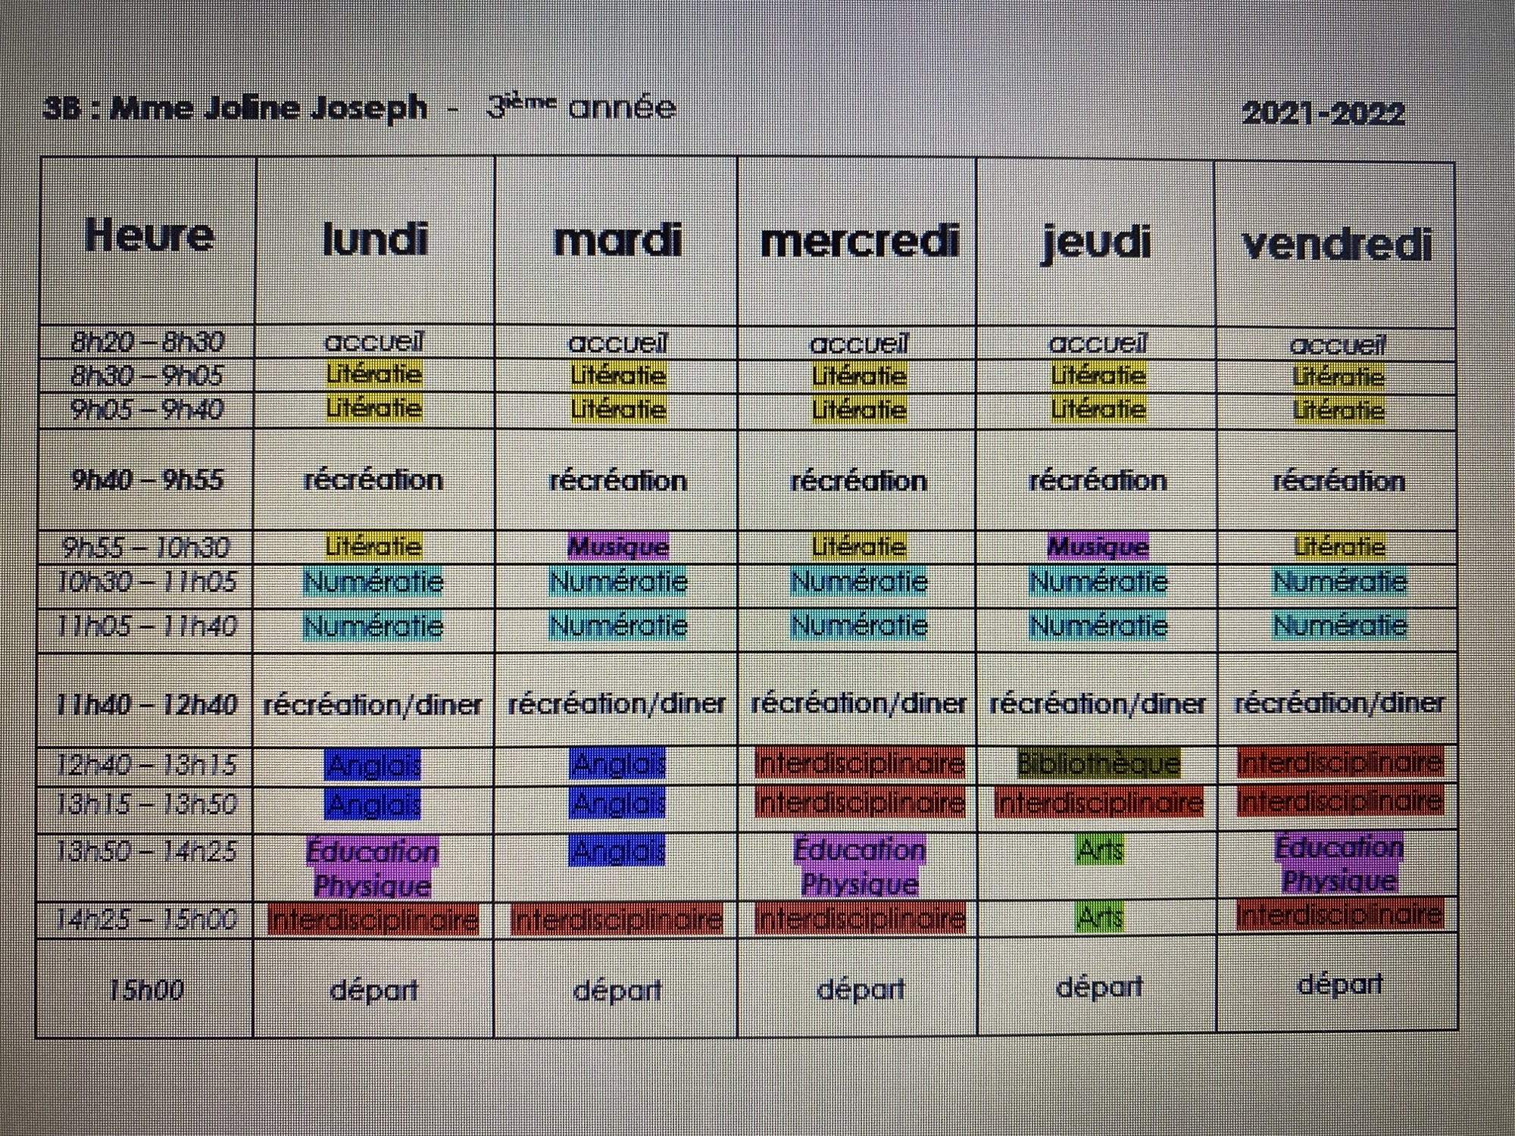
Our schedule

Slide 7
Your child will have French and English reading to do each night. He is responsible to write in his reading log each night.
- 15 minutes of French
- 15 minutes of English
If your child has incomplete work during the day, he or she might be asked to bring it home to complete it. I am hopeful that this will be a rare occurrence, as we do a lot of hands-on work/centers for Literacy as well as Numeracy. ☺

Slide 8
reminders
Your child needs two clean masks each day.
Please check your child’s homework folder each night for important notices/homework.
There are no microwaves in the cafeteria.
Children go play outside in the mornings from 8:00-8:20. Make sure your child is dressed for the weather. ☺

Slide 9
websites
Here are a few websites we will be using regularly in class this year on our iPads.
Literacy
Boukili - https://app.boukili.ca/profils/
Classe Code : eyakw8
Lalilo – https://student.lalilo.com/#/login?language=fr Classe Code : UREXHG
Numeracy
Zorbits - https://play.zorbitsmath.com/
** Students don’t have their login information yet. **

Slide 10
Home learning
In the event of a school closure, your child already has a three-day home learning package.
If the home learning is longer than three days, I will contact you for further information regarding the expectations. ☺

Slide 11
I am looking forward to a great school year!
Merci

