Slide 1
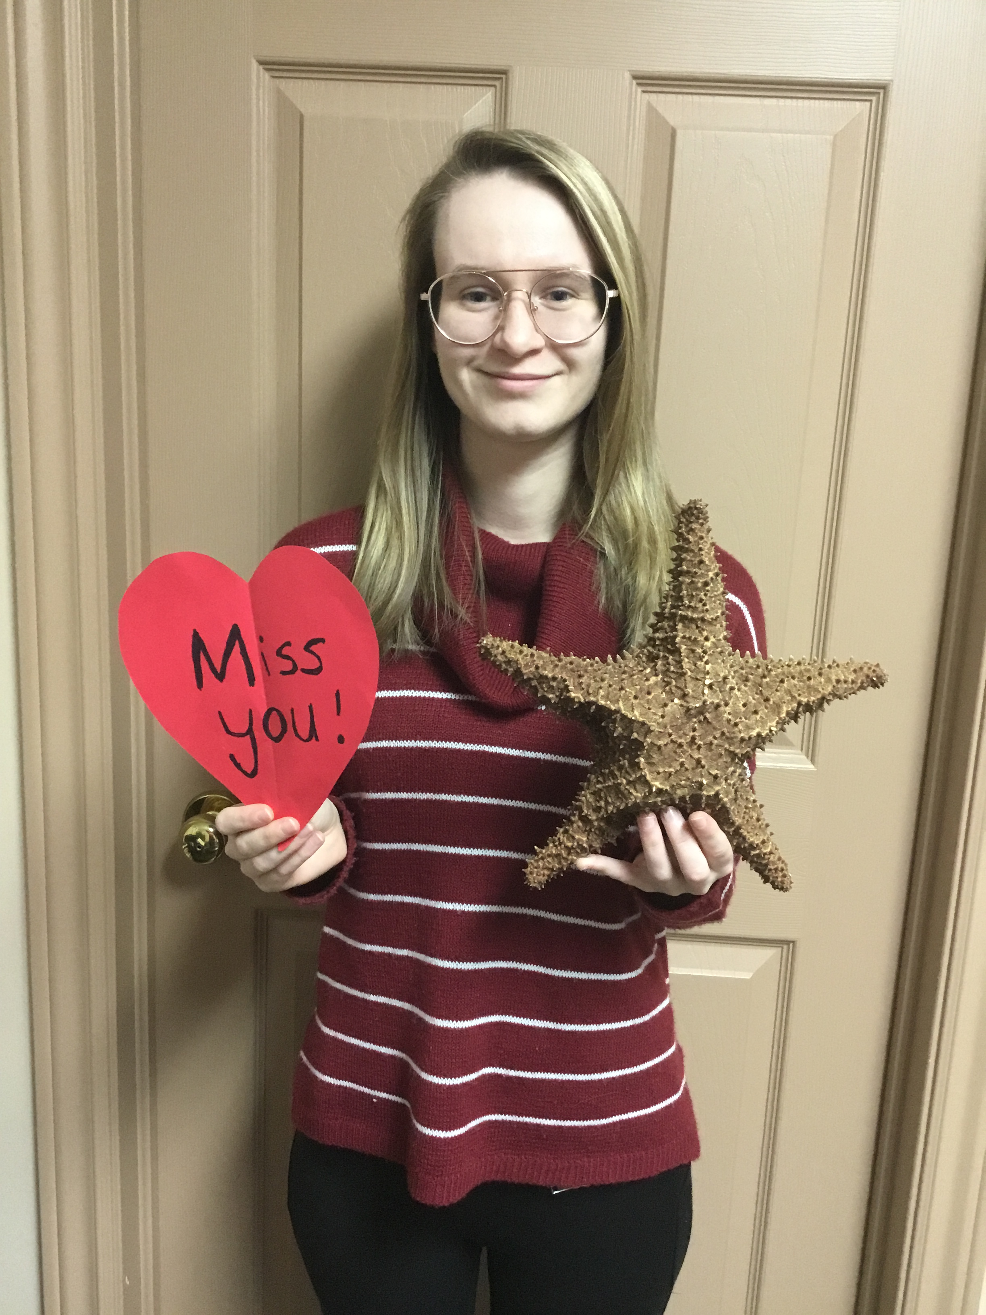
Welcome to Kindergarten (KA)
Miss. Rebecca Flanagan

Slide 2
Learning in Kindergarten
Students will focus on Literacy, Numeracy, and Social/Emotional Learning this year.
Students will spend time each day in purposeful play, both inside and outside the classroom.
Students will take part in weekly Physical Education, Music, and Art classes.
Students will learn how to be an integral part of the classroom family, modelling best behavior, concern for friends, and growing independence.
Kindergarten is all about growing in all of the important ways.

Slide 3
Class Schedule
8:20-8:30- Homeroom/ morning business
8:30- 9:05- Exploratory ( Art on Wednesday)
9:05- 9:40: Specialty ( Mon: Music, Tues: PE, Wed: Art, Thurs: PE, Fri: Music)
9:40- 9:55: Outdoor recess
9:55- 11: 40: Literacy and Center time
11: 40-12:10: Lunch
12:10- 12:40: Outdoor recess
12:40- 1:50: Numeracy ( On Wednesday: PE 1:15-1:50)
1:50- 2:00- Dismissal

Slide 4
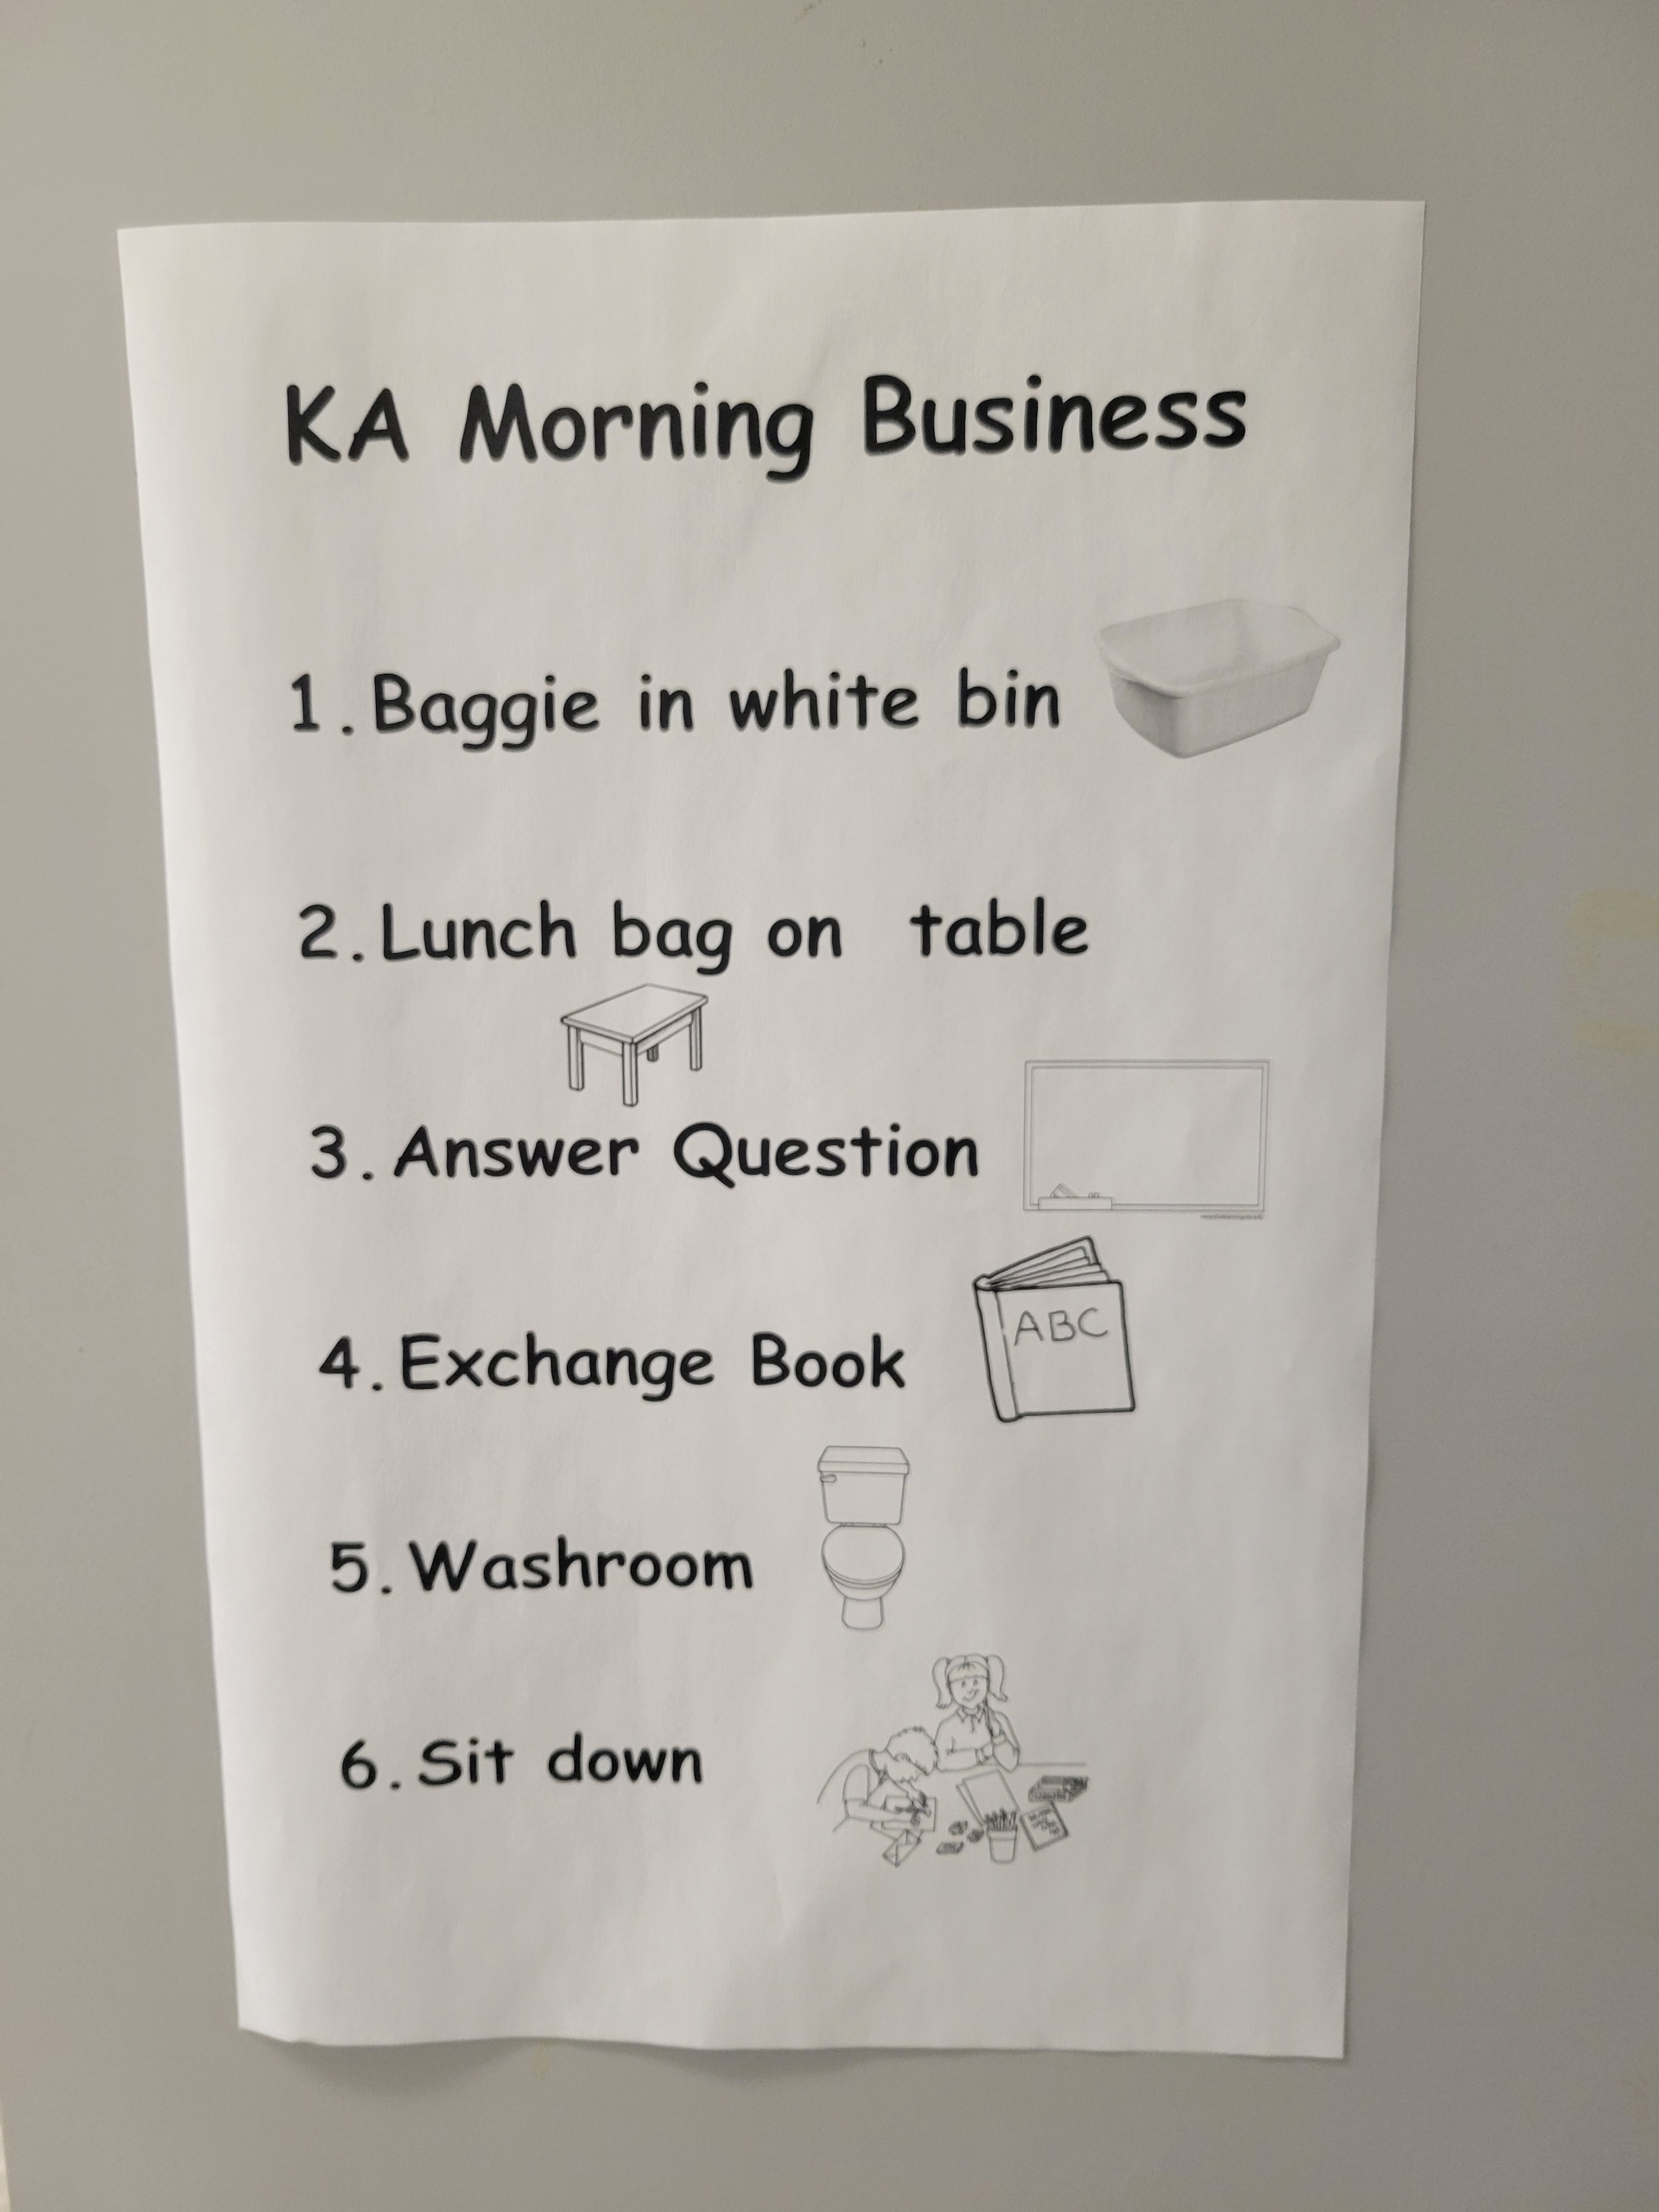
KA Morning Business Students are required to do the following tasks independently when they first arrive in the classroom:
White baggie in bin
Lunch bag on table
Answer question on the board
Exchange books
* Students cannot pick a new book if they did not return their previous book back to school.
Go to Washroom
Sit down and do activity on the table until announcements

Slide 5
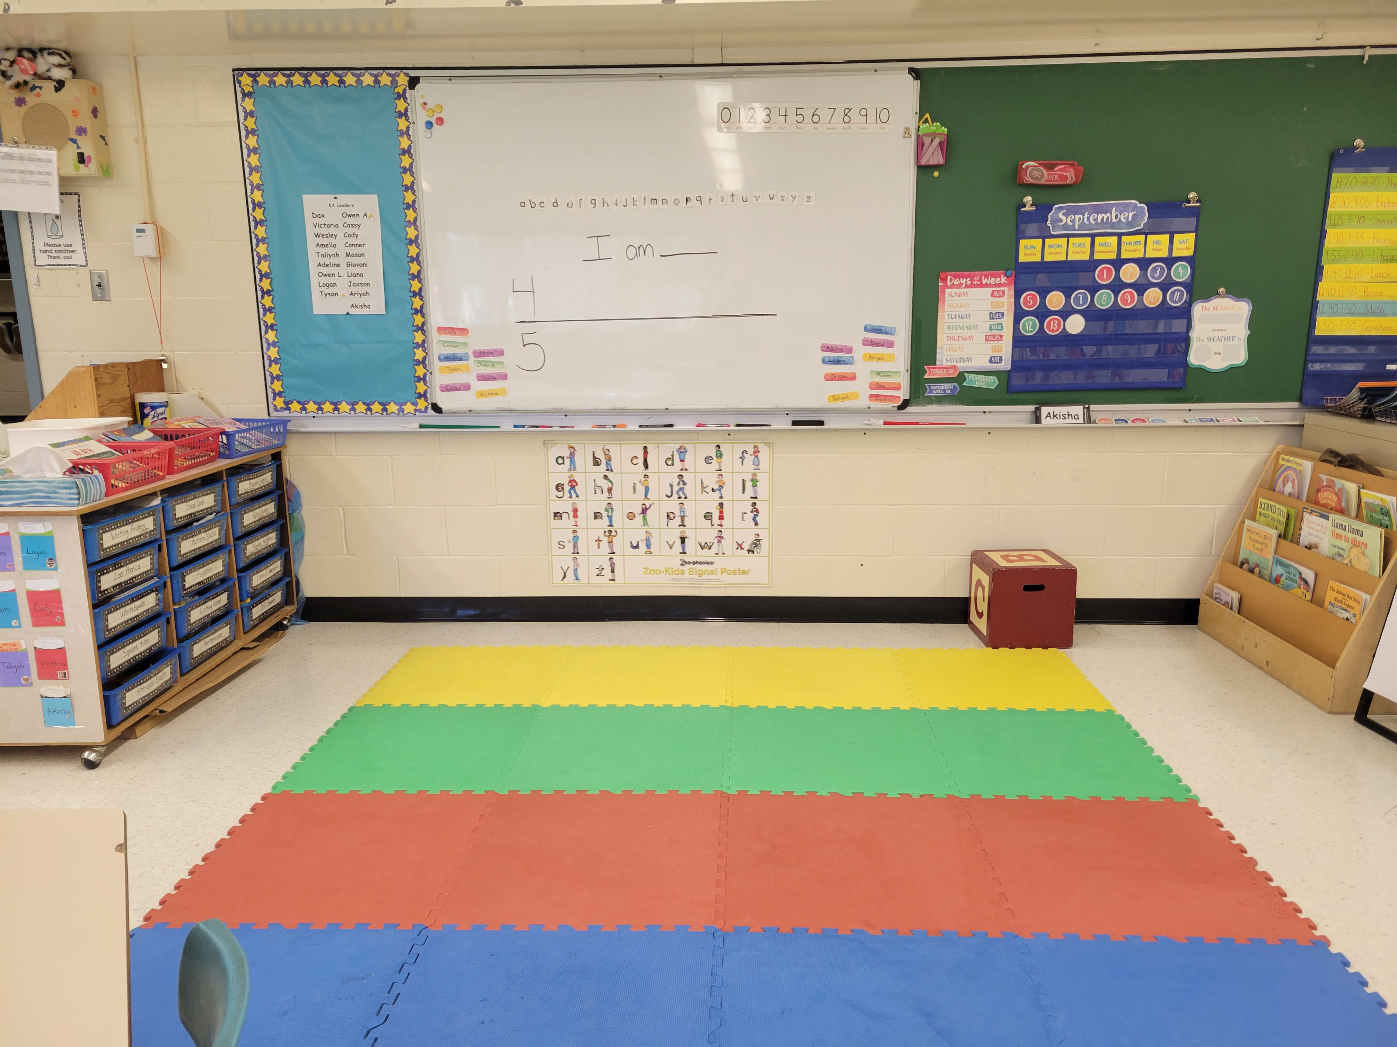
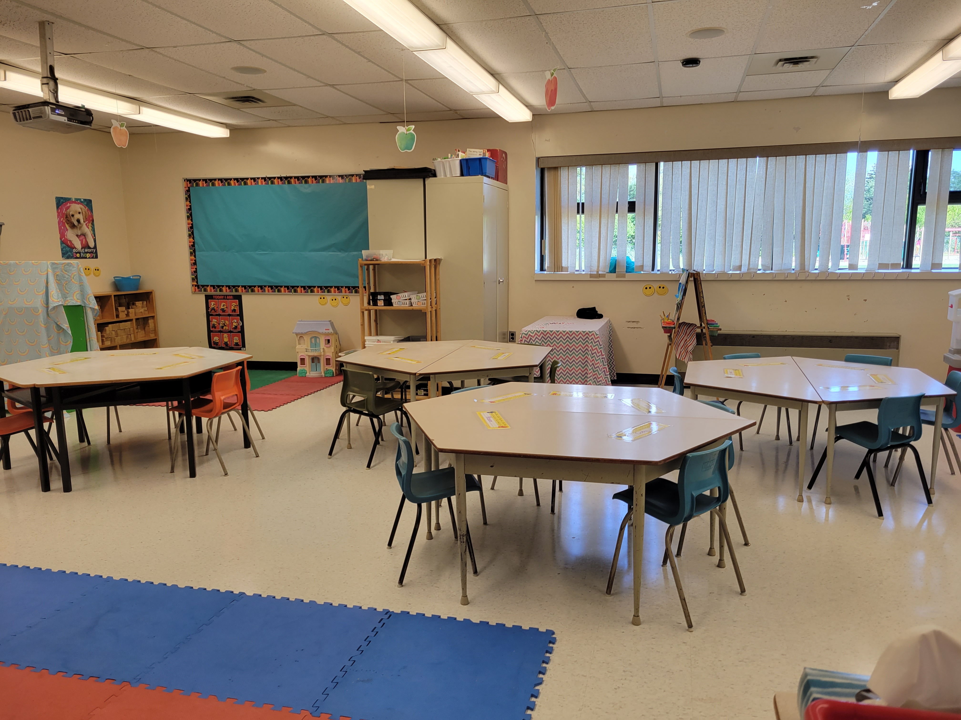
Our Classroom

Slide 6
Our Classroom

Slide 7
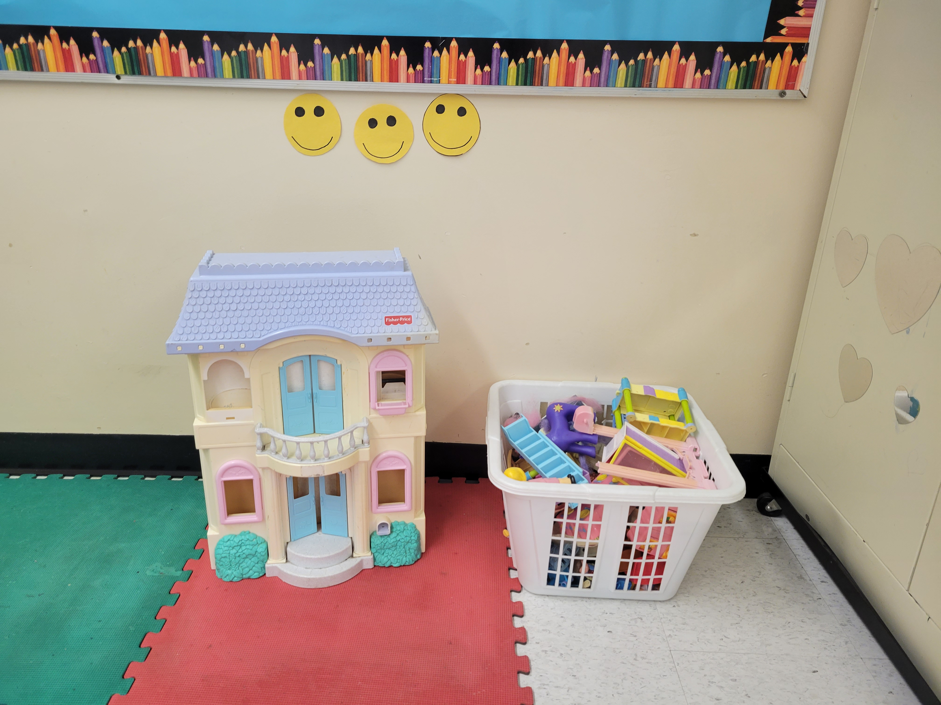
Purposeful Play Centers
RULES FOR CENTERS:
The smiley faces indicate how many students can play there.
If students wish to play there or at any other center, students must wait for someone to leave or ask if they can play there later.
Students must clean up their own toys before moving on to a new center.
Dollhouse center

Slide 8
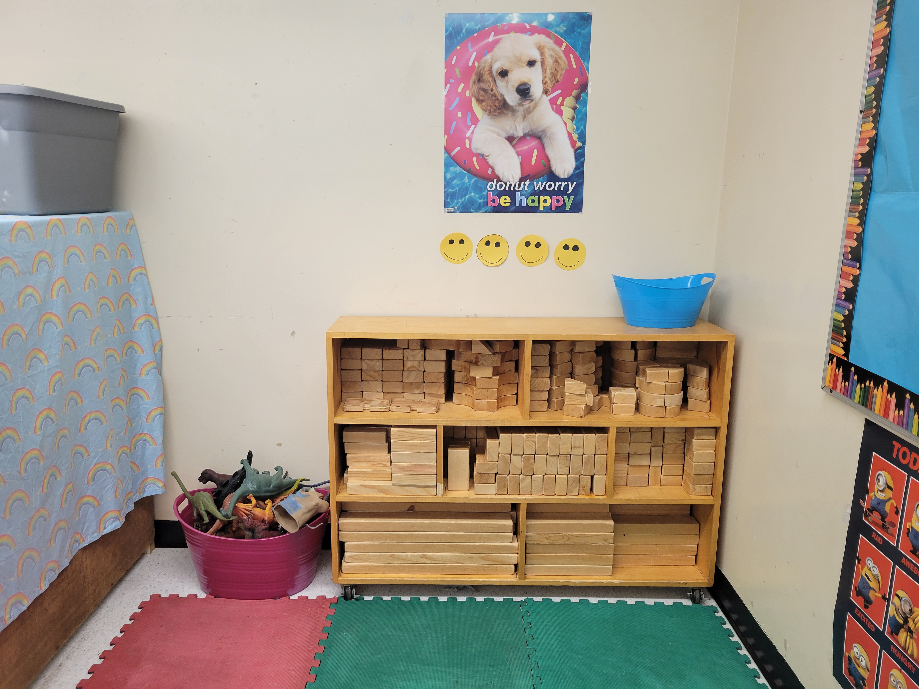
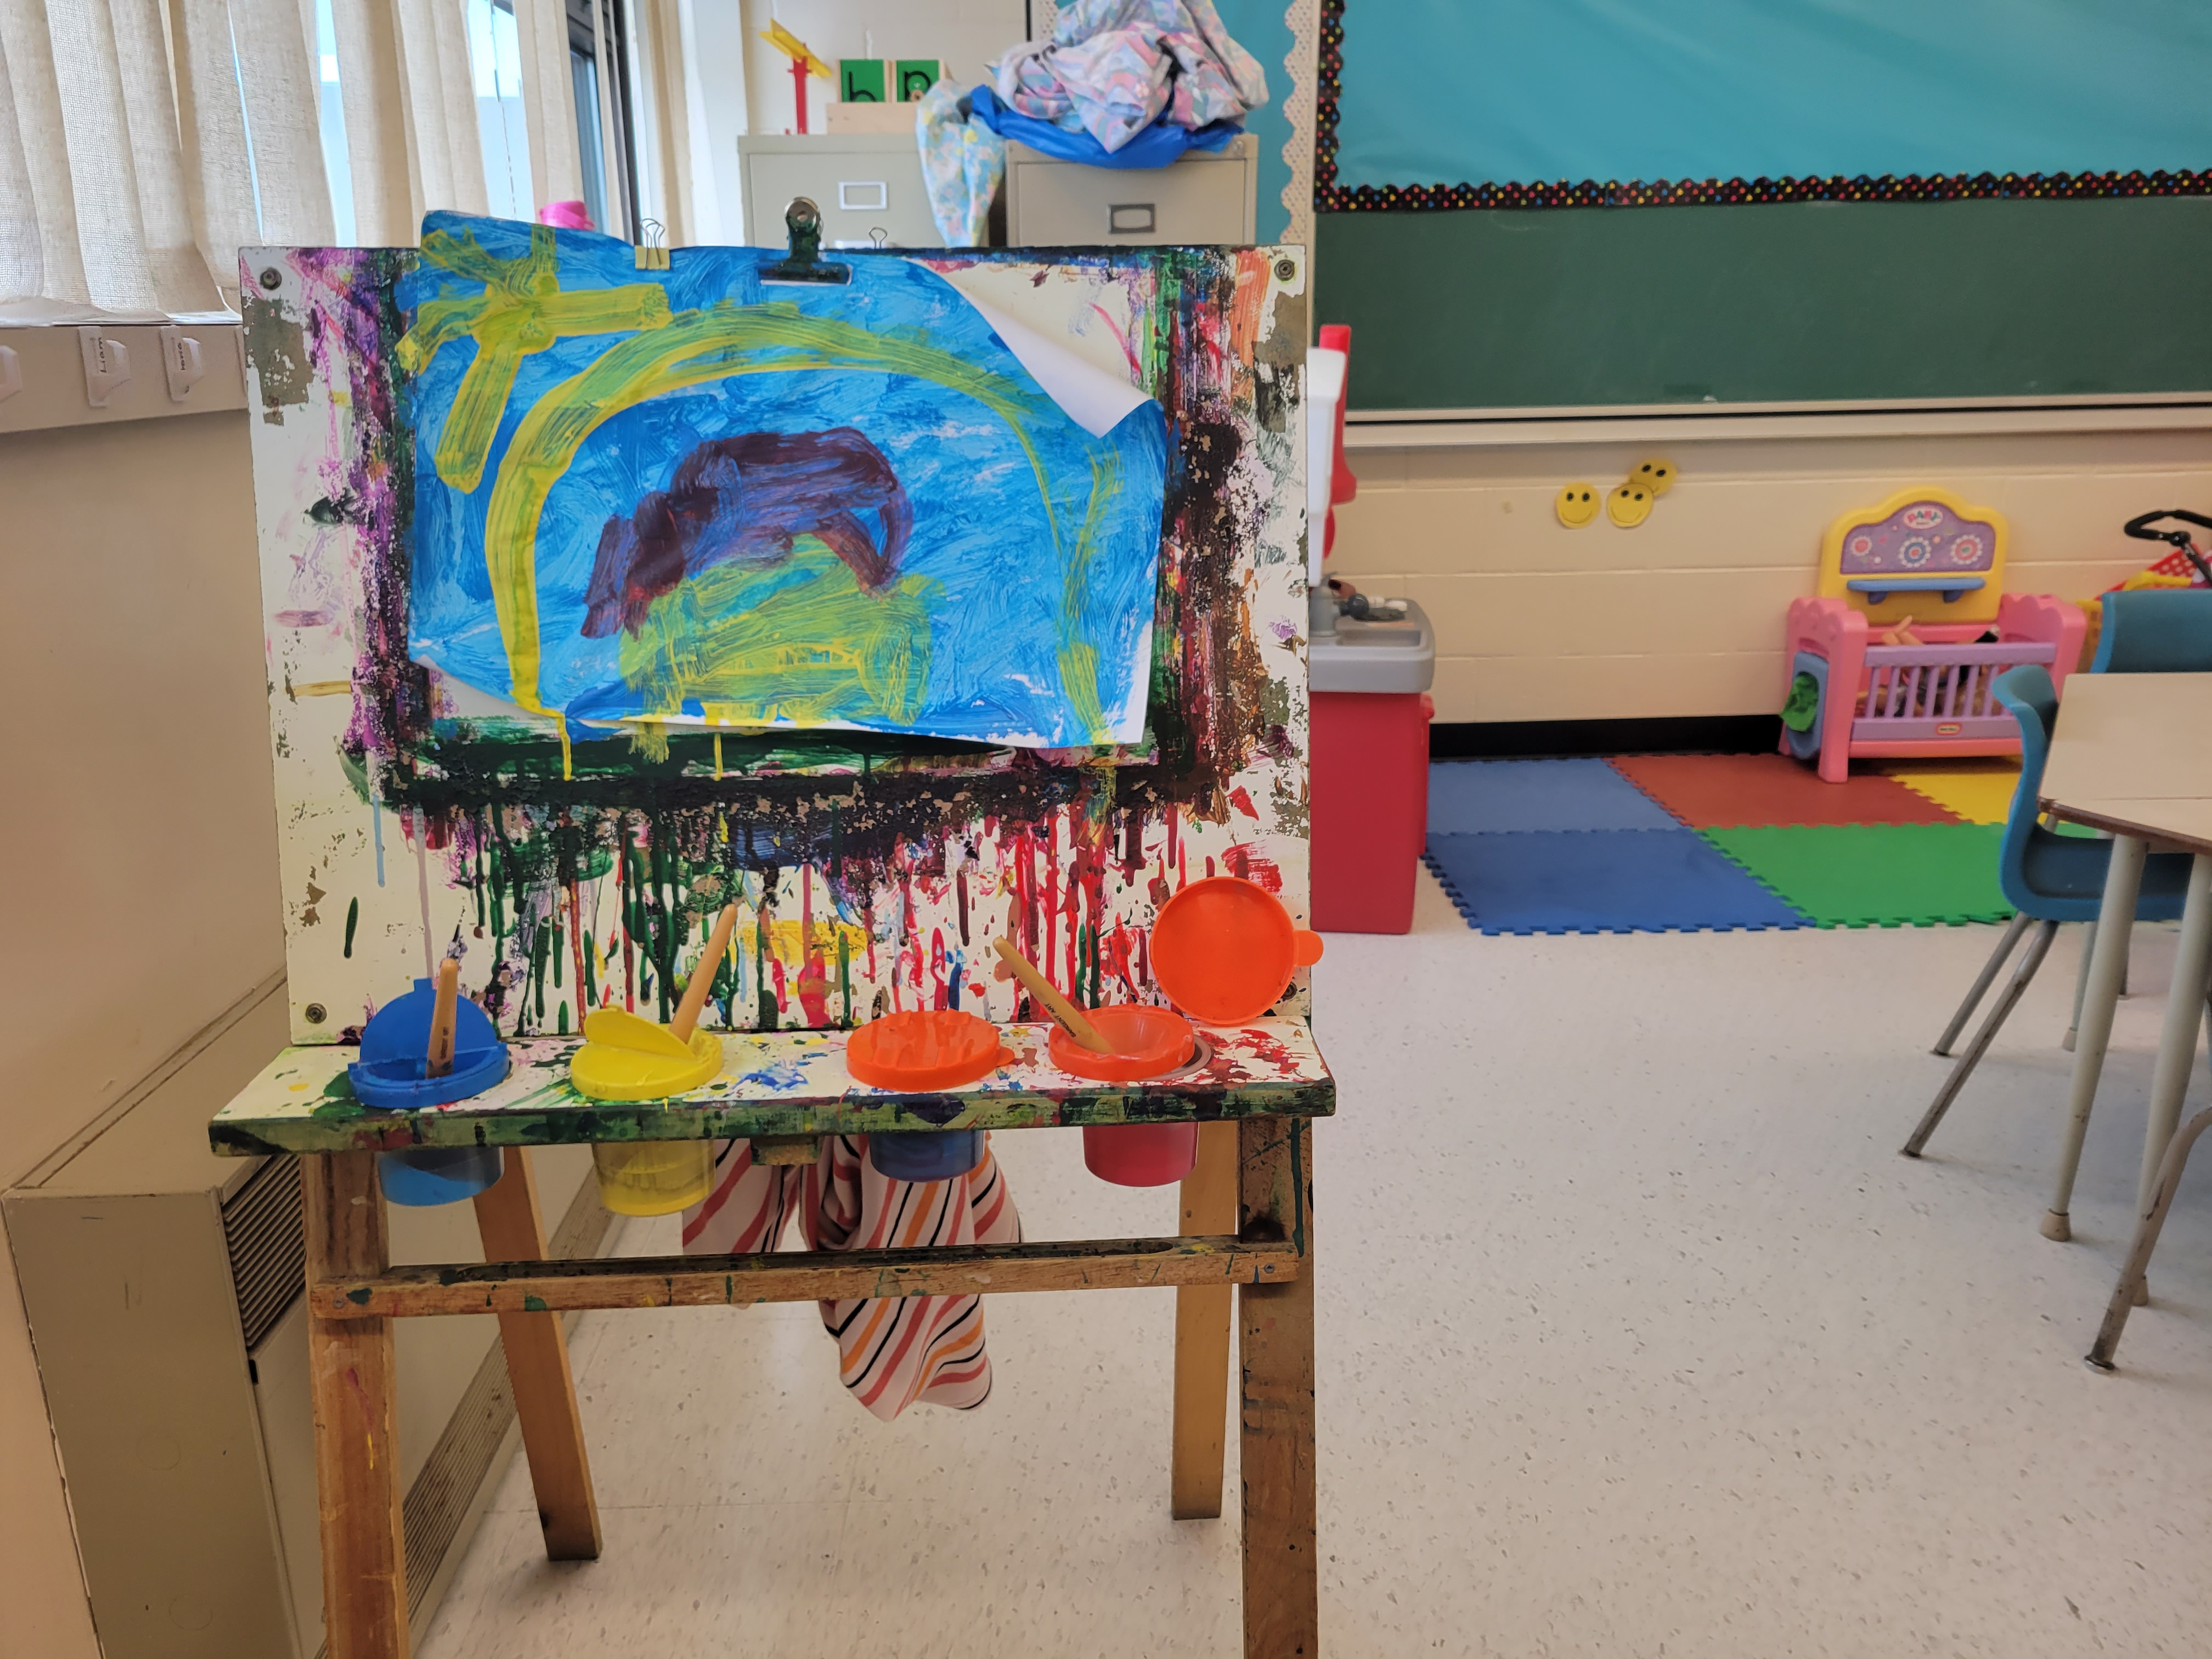
Block and dinosaur center
Paint Center

Slide 9
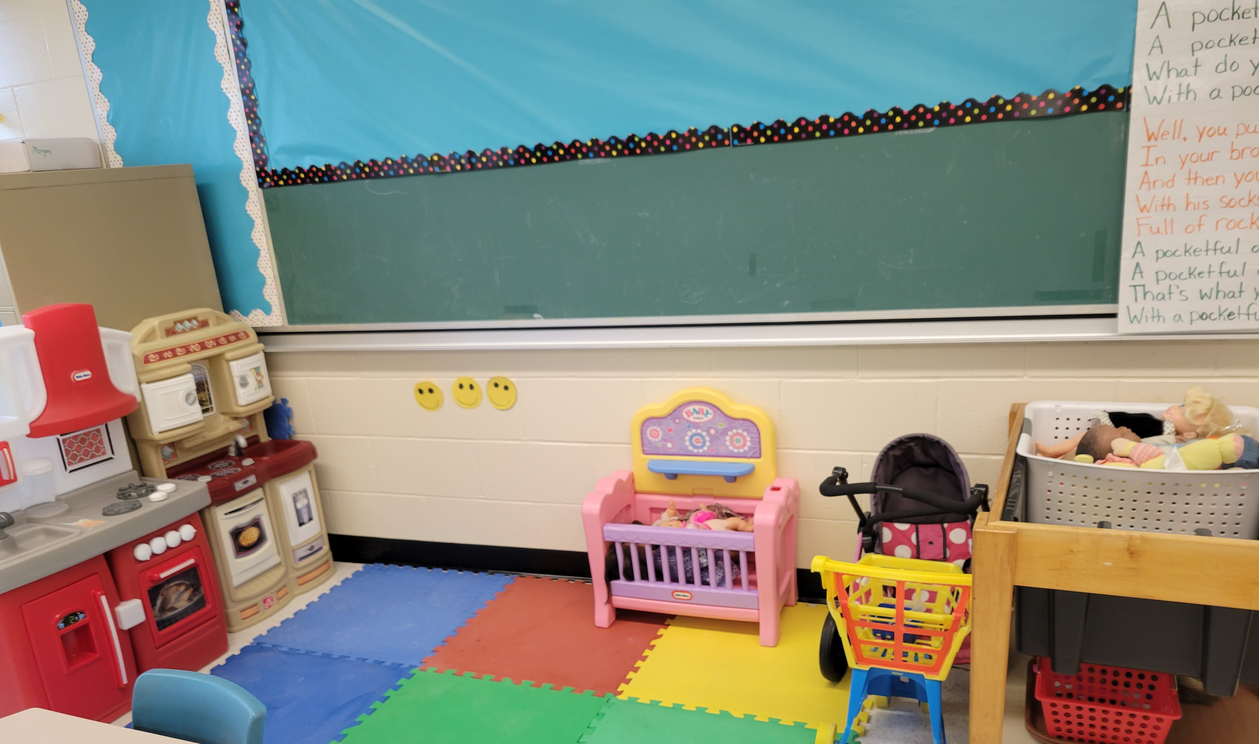
Home Center

Slide 10
Classroom Rules and Expectations
123 Magic is a program used in Kindergarten to reduce unwanted behaviours and encourage wanted behaviours. When a student receives a #1, they are to stop right away. If they get a #2, they are to stop right away and think about whole-body listening. If they get the #3, they are to take 5 minutes to sit, think and have a chat with the teacher.
Our I-Care Rules
We listen to each other
Hands are for helping, not hurting
We use I-care language
We care about each other’s feelings
We are responsible for what we say and do

Slide 11
Contact Information:
Feel free to contact me :
1) Via email: rebecca.flanagan@nbed.nb.ca
2) Rexton Elementary School – 523-7152 and leave a message and I will get back to you as soon as possible
3) Written note in your child’s homework baggie
I look forward to working with your child this year!

