Slide 1
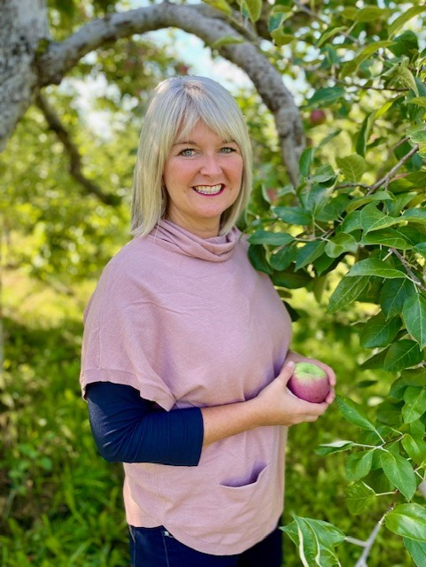
Welcome to Mrs. S. Flanagan’s Grade 2A Class 2021 – 2022

Slide 2
Our daily class schedule for Grade 2A is as follows:
8:20 - 8:30 | Students arrive in class, attendance is taken and morning routine
8:30 – 9:05 | Gym (M/W/F) and Music (T/Th)
9:05 - 9:40 | Exploratory
9:40 – 9:55 | Recess (snack time)
9:55 - 11:40 | Literacy Block
11:40 – 12:10 | Lunch in the cafeteria for K - 2
12:10 – 12:40 | Recess for K - 2
12:40 – 1:50 | Math Block
1:50 – 2:00 | Prepare for dismissal
2:00 | Dismissal
 | Gym is taught by Miss Murphy
 | Music is taught by Mrs. Volpé

Slide 3
Take a look inside our grade 2 class…
2Awesome!
Notes:
NOTE: To change images on this slide, select a picture and delete it. Then click the Insert Picture icon in the placeholder to insert your own image.

Slide 4
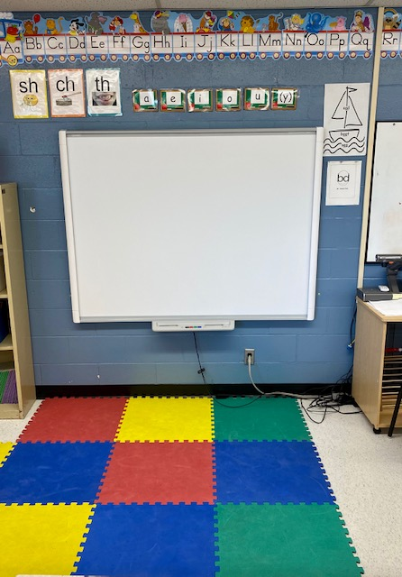
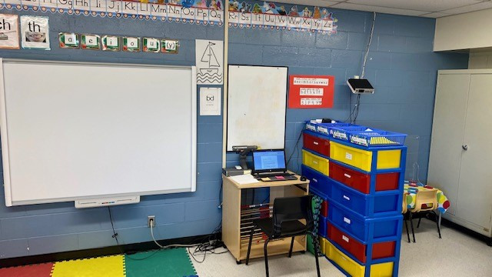
SMART Board Learning Area
Notes:
NOTE: To change images on this slide, select a picture and delete it. Then click the Insert Picture icon in the placeholder to insert your own image.

Slide 5
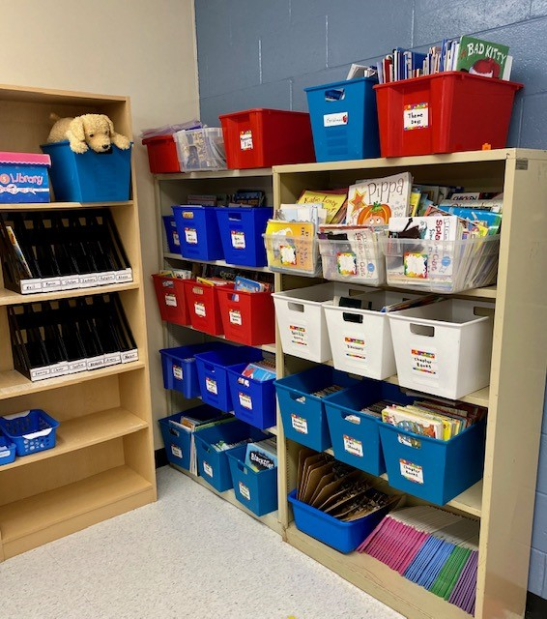
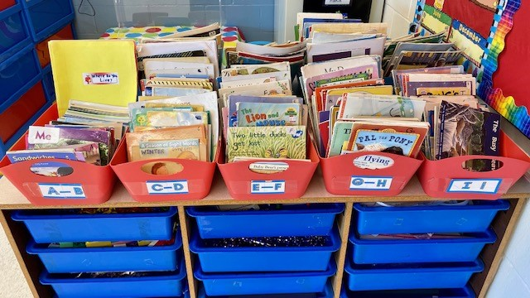
We have a large variety of books for all interests!
Notes:
NOTE: To change images on this slide, select a picture and delete it. Then click the Insert Picture icon in the placeholder to insert your own image.

Slide 6
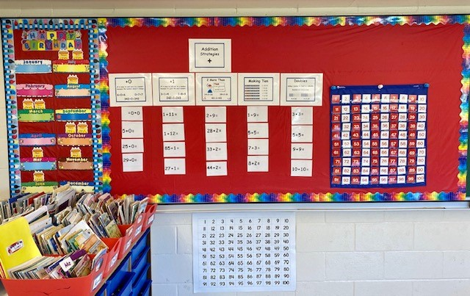
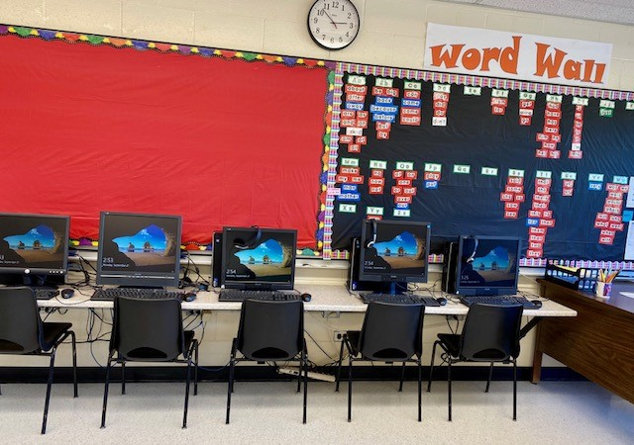
Here are a few of our classroom tools…
Notes:
NOTE: To change images on this slide, select a picture and delete it. Then click the Insert Picture icon in the placeholder to insert your own image.

Slide 7
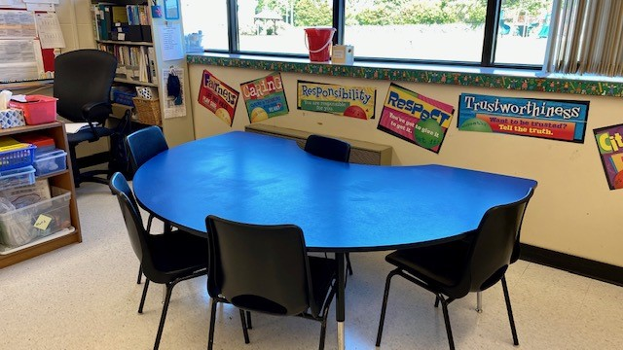
Our classroom also has spaces to work with a partner or in a small group.

