Slide 1
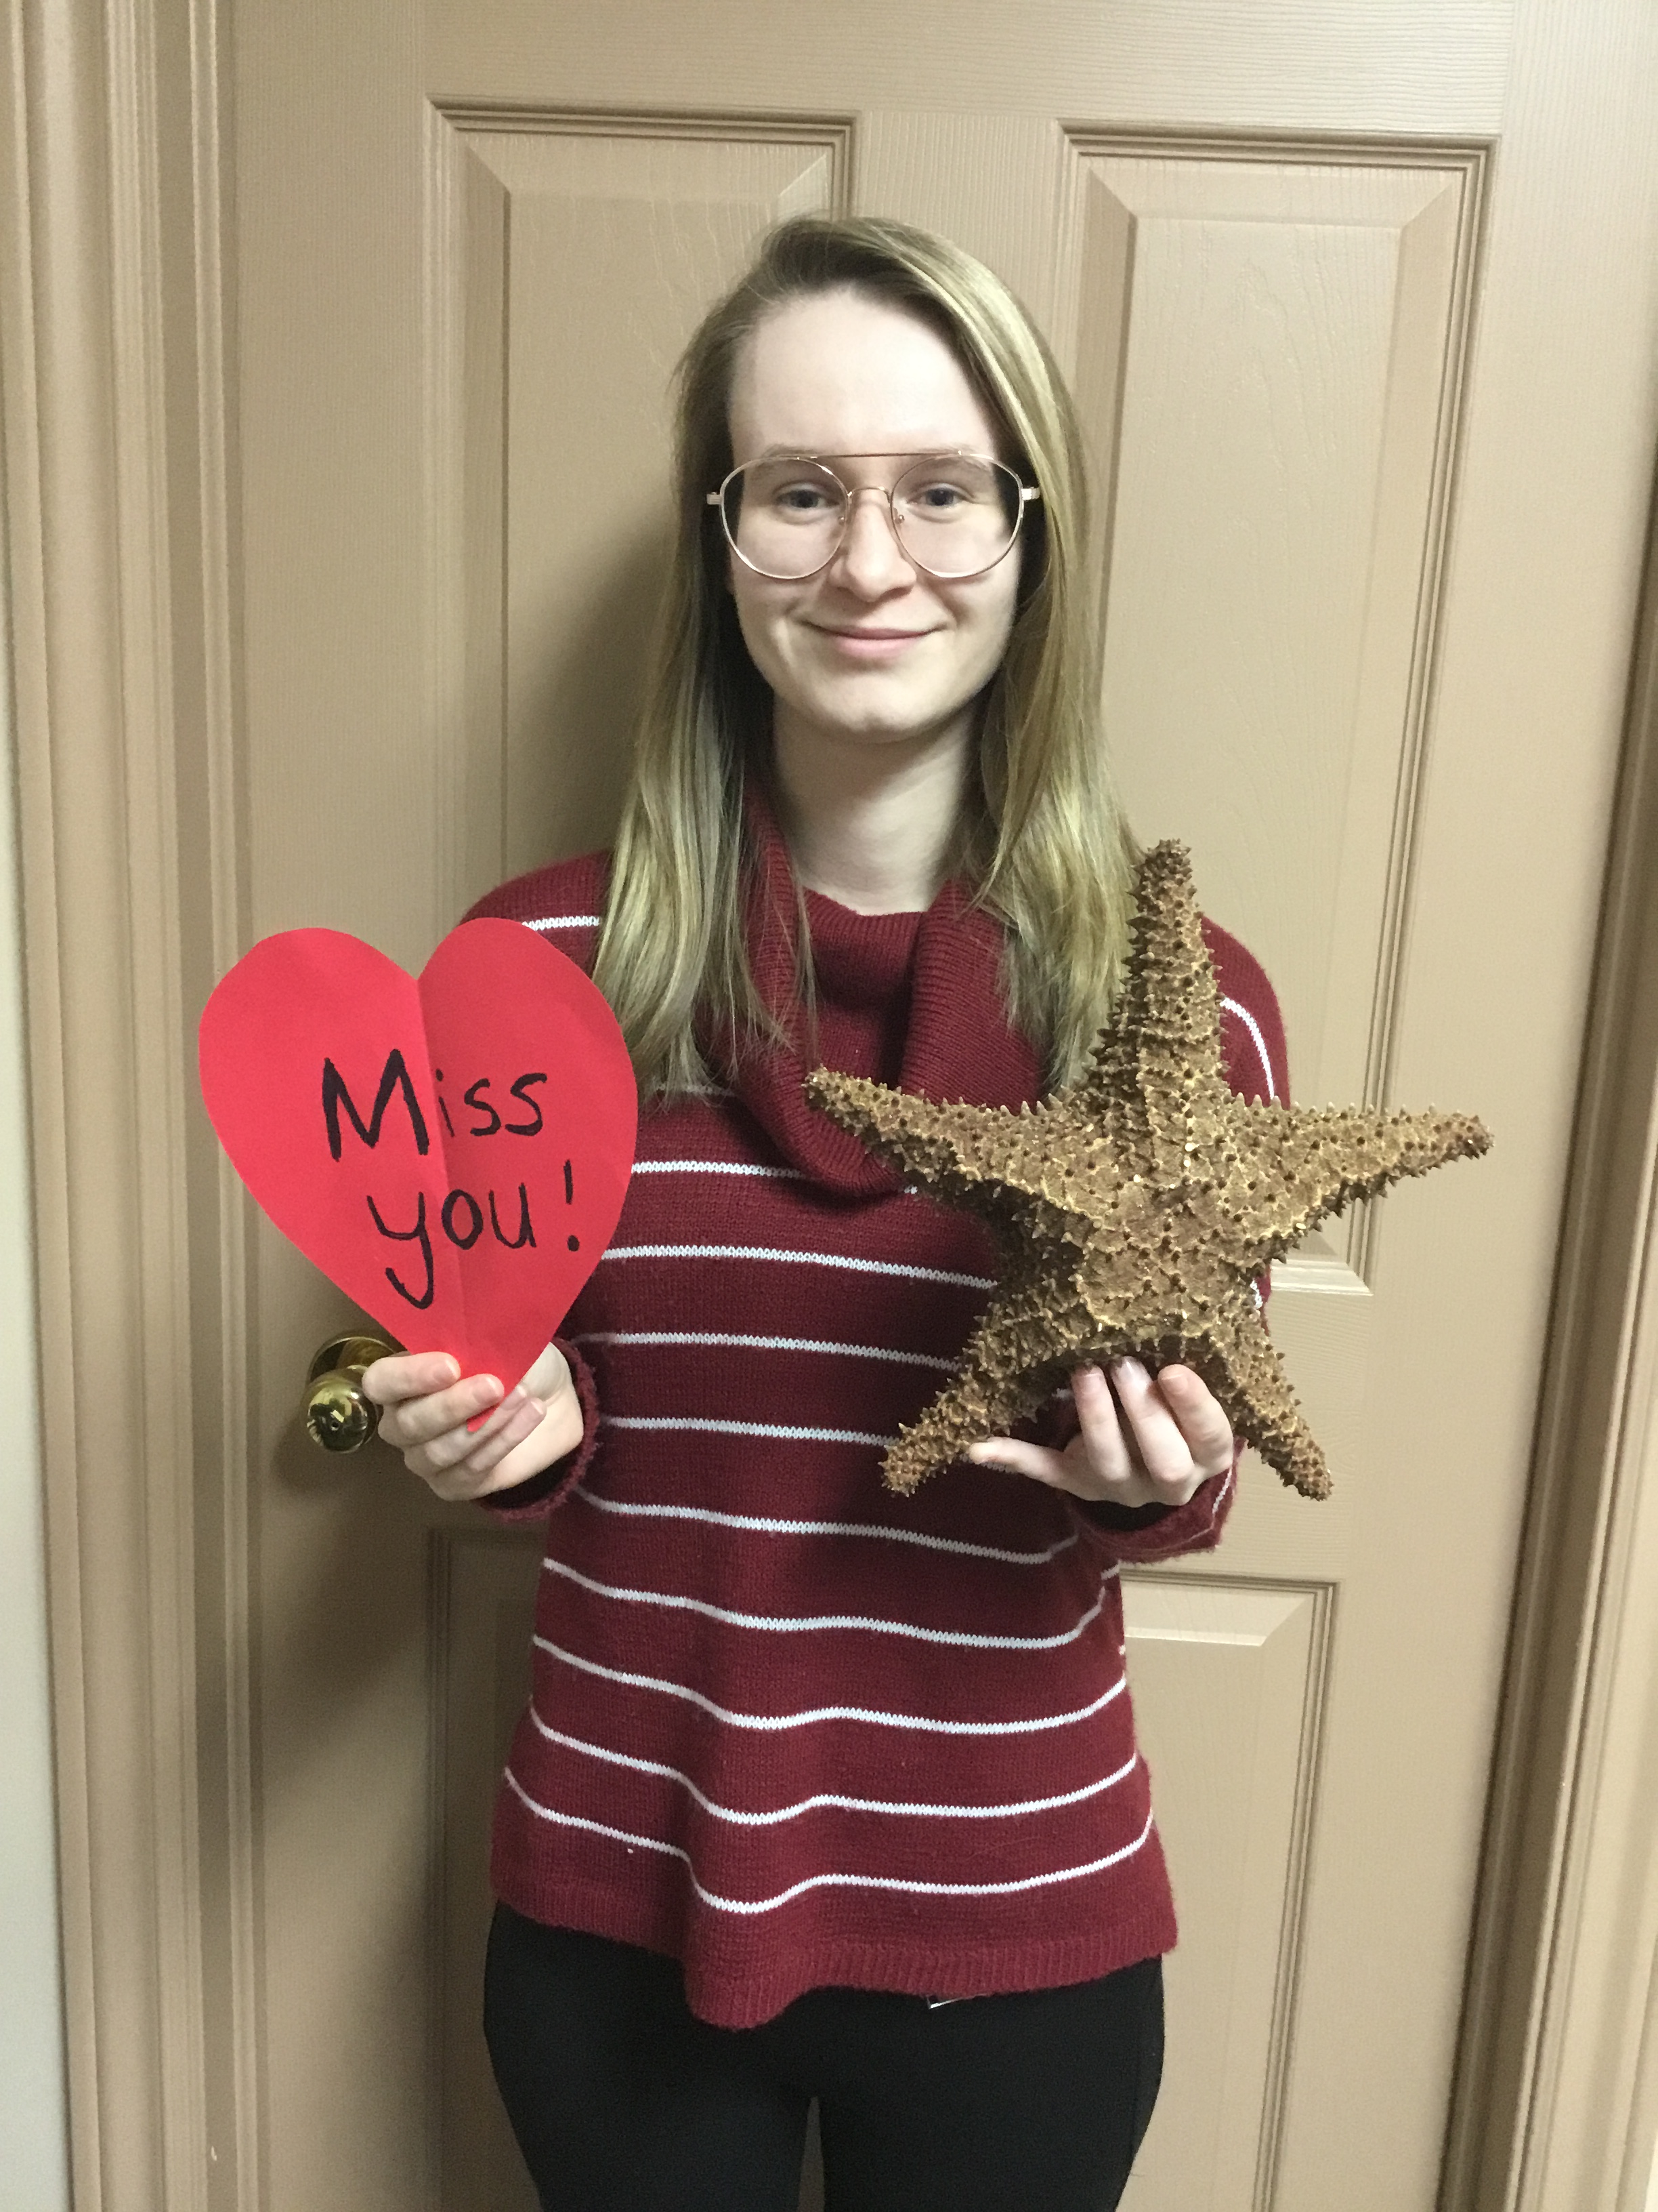
KC Virtual Classroom Tour
Miss. Rebecca Flanagan

Slide 2
Learning in Kindergarten
Students will focus on Literacy, Numeracy, and Social/Emotional Learning this year.
Students will spend time each day in purposeful play, both inside and outside the classroom.
Students will take part in weekly Physical Education, Music, Art, STEM, and Indigenous Studies classes.
Students will learn how to be an integral part of the classroom family, modelling best behaviour, concern for friends, and growing independence.
Kindergarten is all about growing in all of the important ways.

Slide 3
Our Classroom

Slide 4
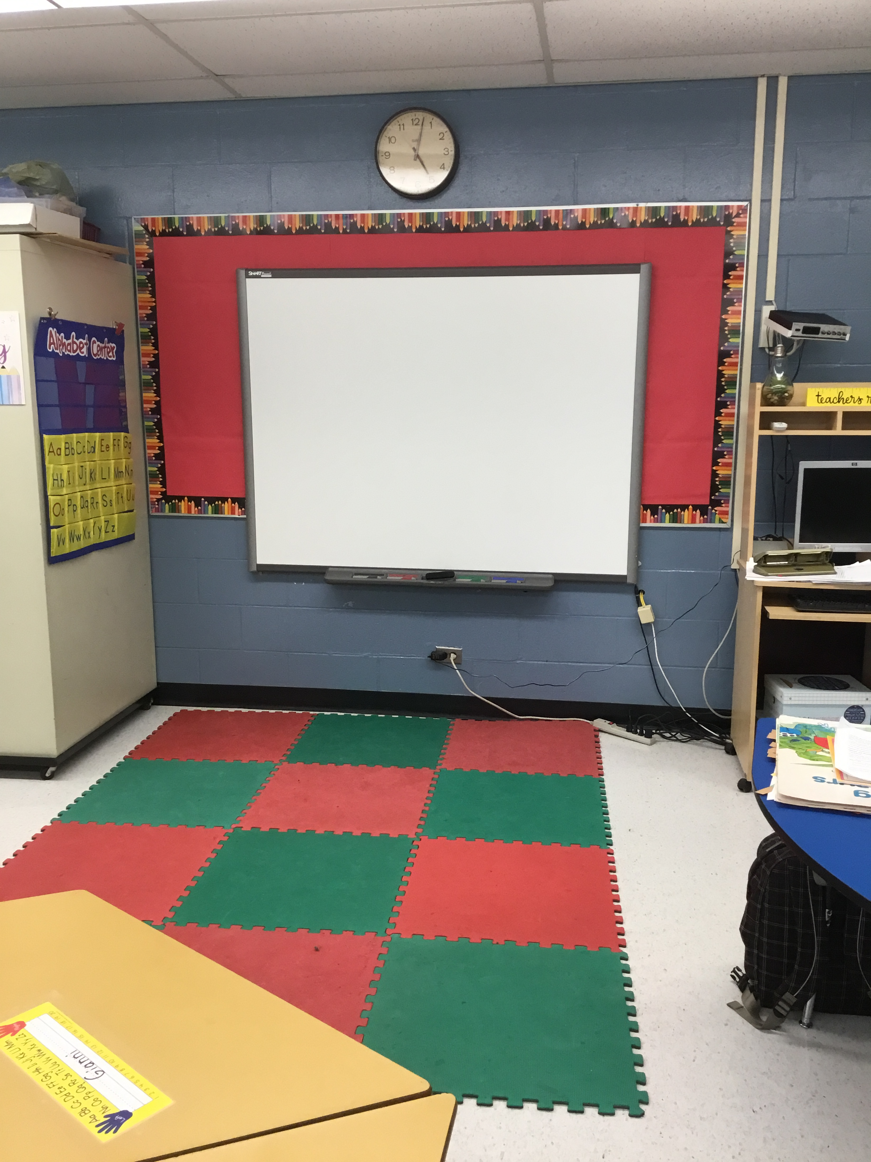
Our Smart Board

Slide 5
Our Discovery Center

Slide 6
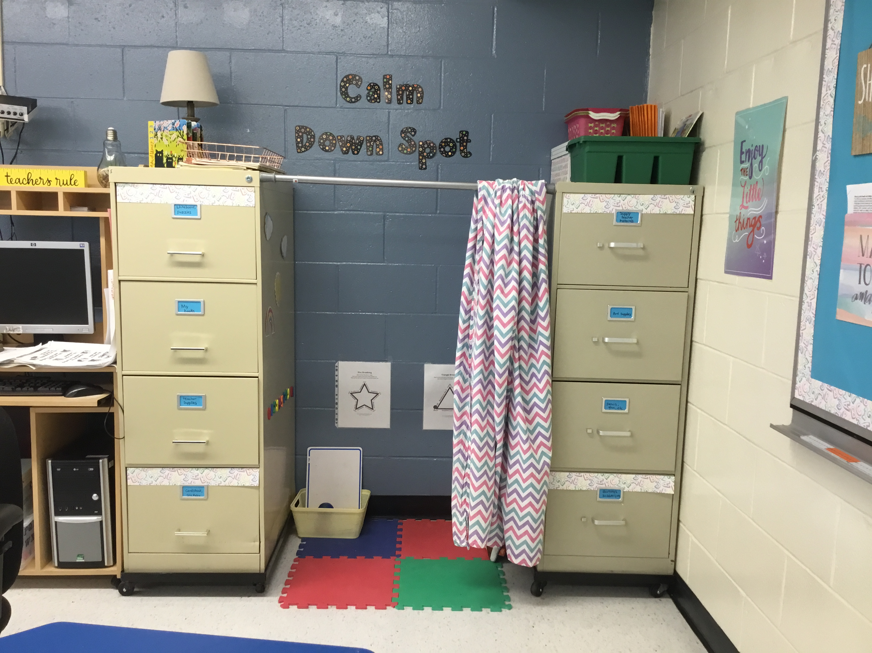
Our Calm Down Spot
This is a safe space where kids can practice self-regulation skills and work to calm themselves down. Also a place where they learn from their mistakes.

Slide 7
KC Morning Business
White baggie in bin
Lunch bag on table
Answer question on the board
Exchange books
Washroom
Sit down at table

Slide 8
Classroom Rules and Expectations
123 Magic is a program used in KC to reduce unwanted behaviours and encourage wanted behaviours. When a student receives a #1, they are to stop right away. If they get a #2, they are to stop right away and think about whole-body listening. If they get the #3, they are to take 5 minutes to sit, think and have a chat with the teacher.
Our I-Care Rules
We listen to each other
Hands are for helping, not hurting
We use I-care language
We care about each other’s feelings
We are responsible for what we say and do

Slide 9
Feel free to contact me :
1) Via email: rebecca.flanagan@nbed.nb.ca
2) Rexton Elementary School – 523-7152 and leave a message
3) Written note in your child’s homework baggie
I look forward to working with your child this year!

