Slide 1
KA
Virtual Open House
September 24, 2020

Slide 2
Welcome KA Families!
Goals for this virtual open house:
To introduce KA’s teacher, Ms. Gallivan
To help you understand some of the work you child will be doing throughout the school year.
To explain classroom expectations.
To share information about how families can support their child’s learning.

Slide 3
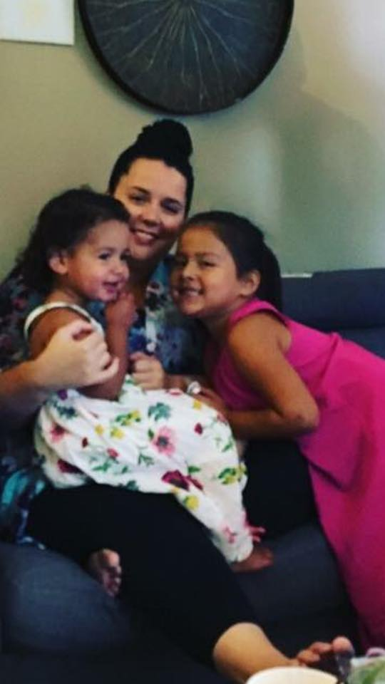
Meet Ms. Gallivan
I am SO thrilled to be KA’s teacher this year! It is going to be a fun-filled year with lots of learning and adventure.
I was born and raised in Miramichi, New Brunswick. I have taught in the Rexton area for 11 years, 8 of which have been at Rexton Elementary. I have a Bachelor of Arts, a Bachelor of Education and a Masters in Education, all from the University of New Brunswick. This is my 13th year of teaching and my first year as RES’ Vice Principal. I have taught middle and high school, but I have spent most of my time teaching elementary school and it is definitely where my passion lies.
I look forward to getting to know you all this year!
Me with my nieces Mayci and Madison!

Slide 4
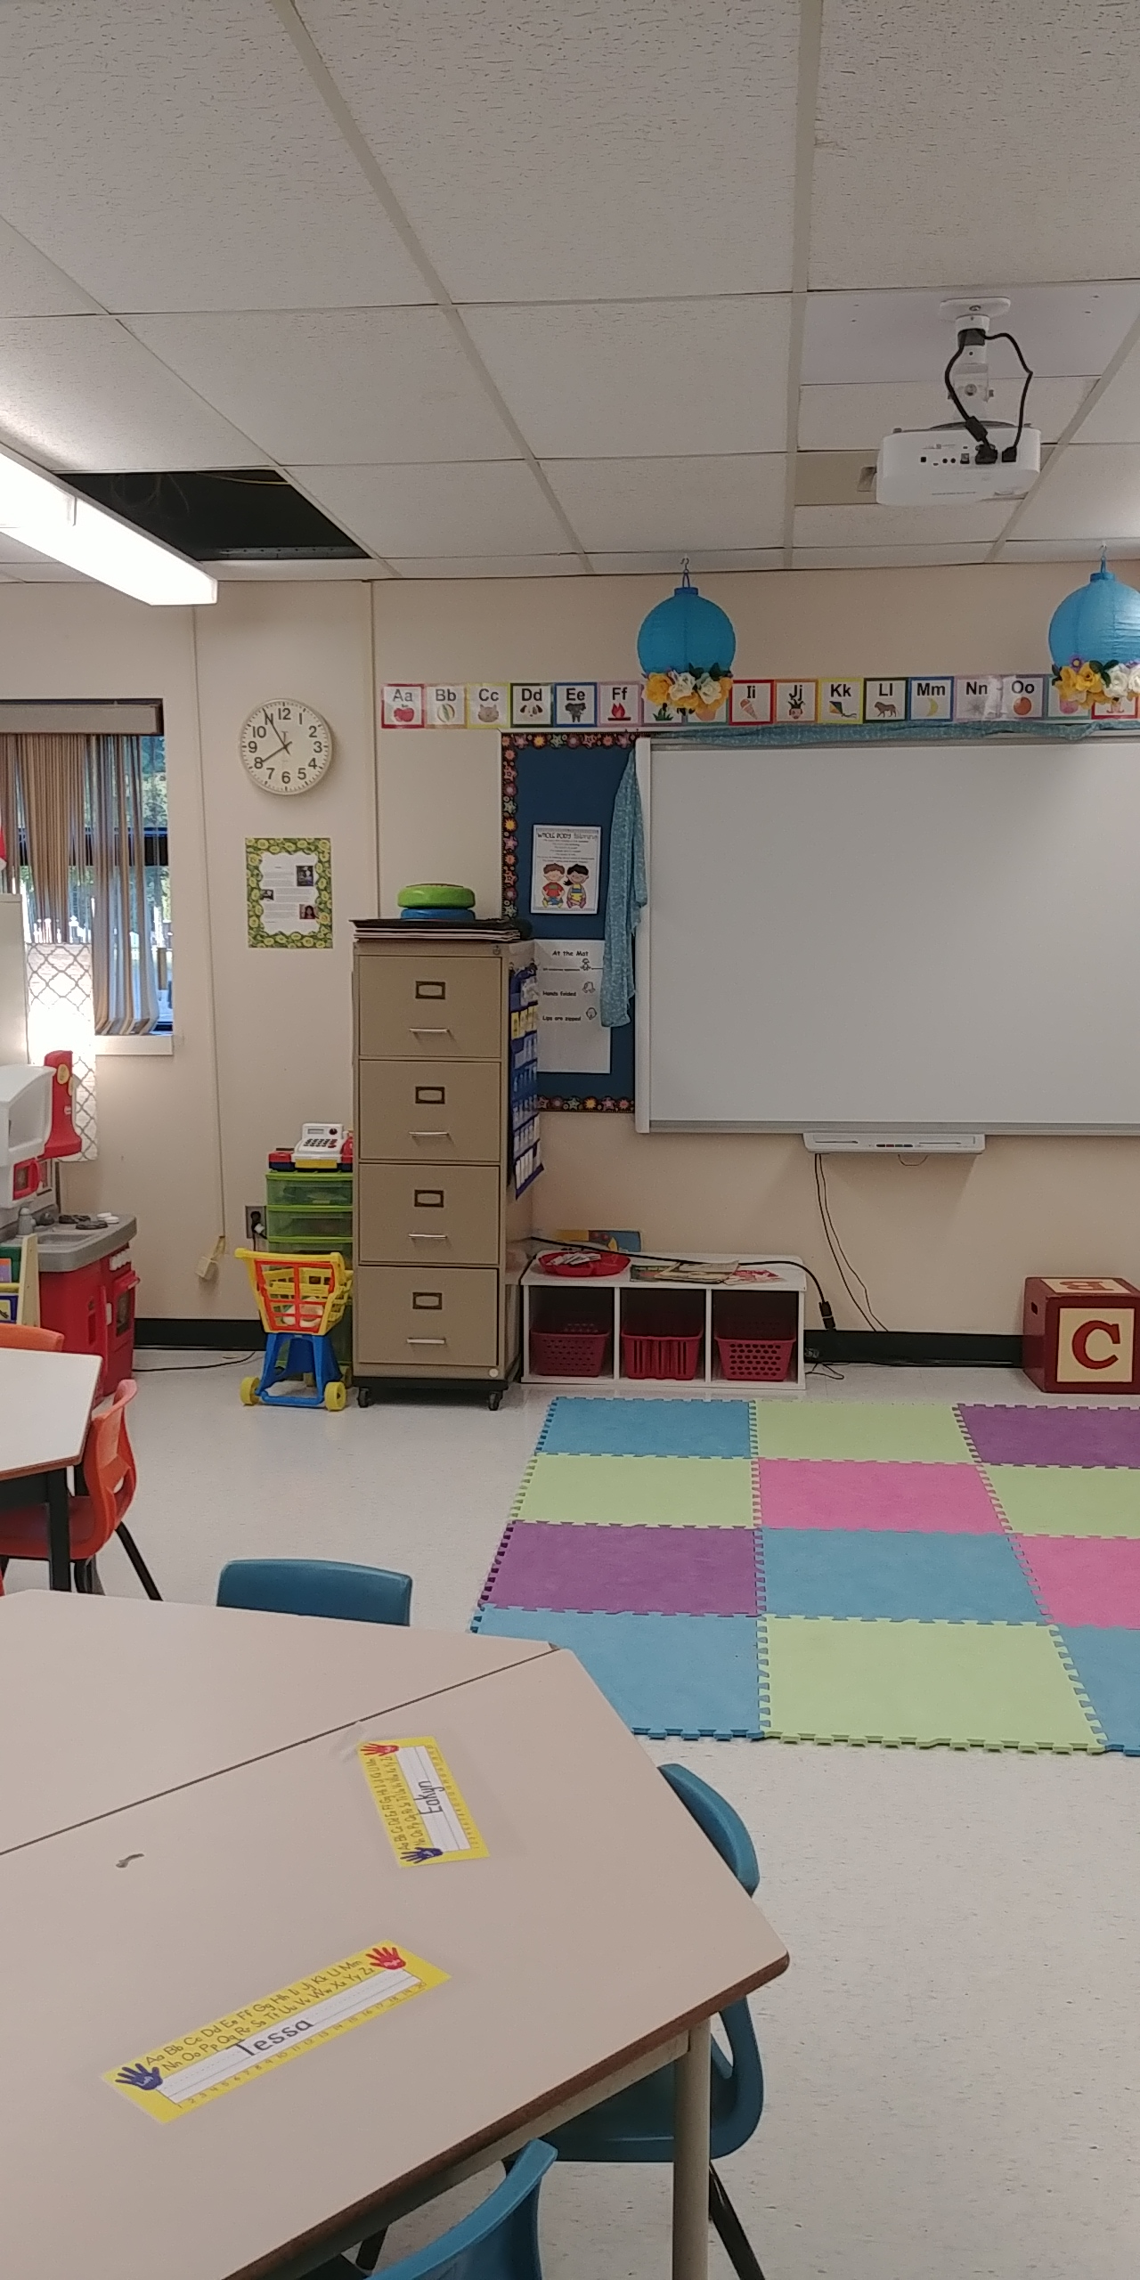
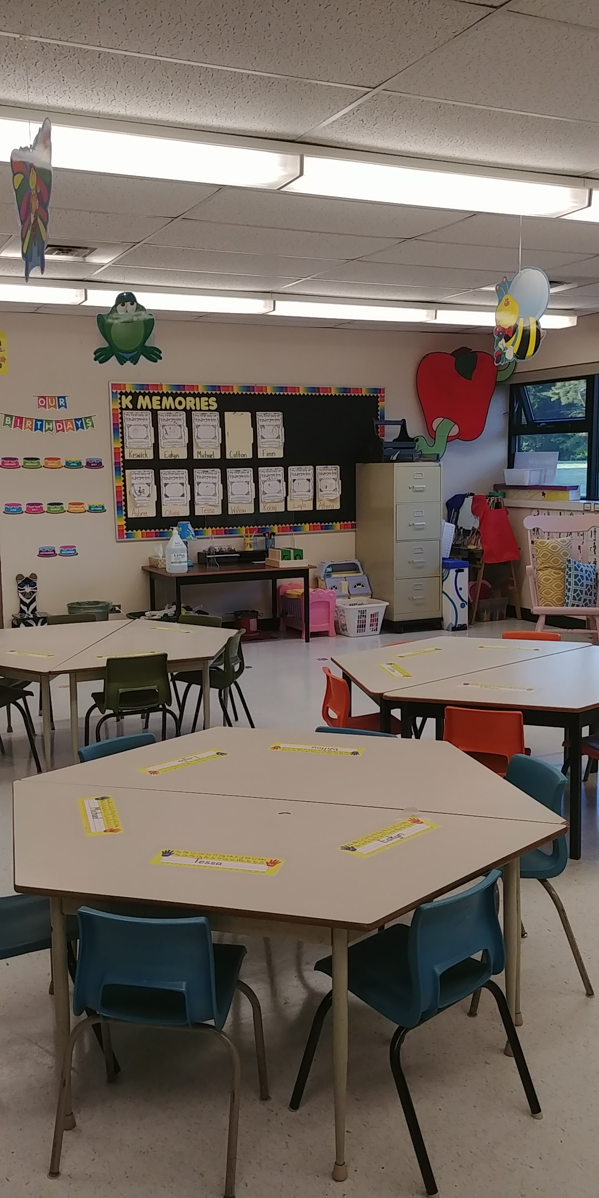
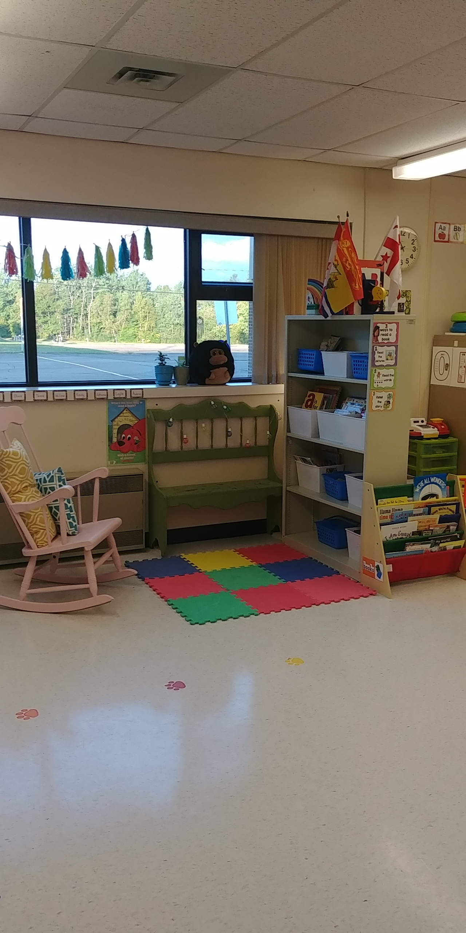
Our Classroom
The mat and SmartBoard area, where we a lot of learning happens!
Our tables- we have a frog, butterfly and bumblebee table.
The classroom library. Students love to rock in the rocking chair, while looking at books!

Slide 5
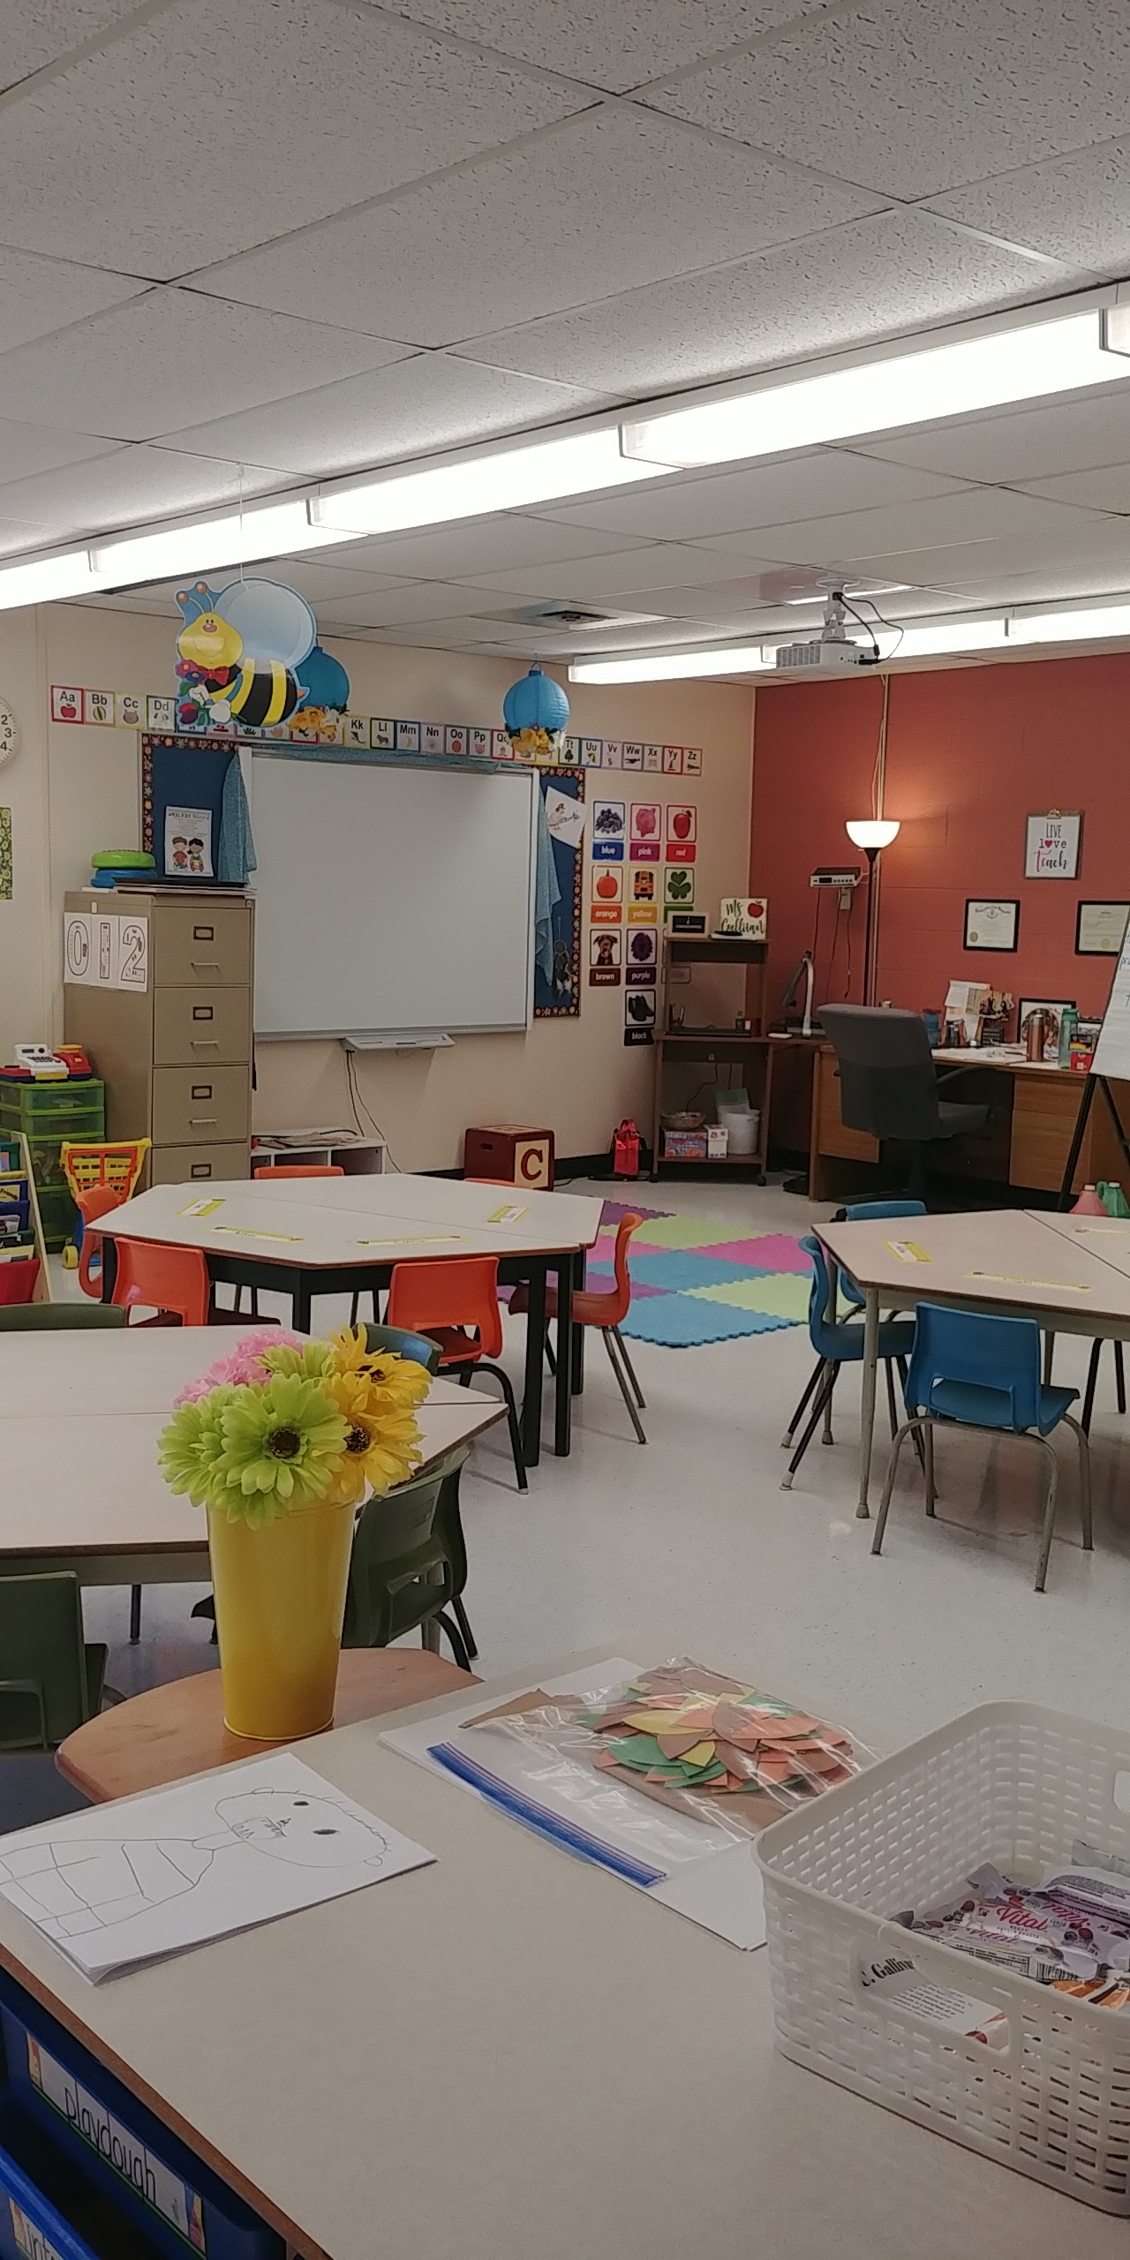
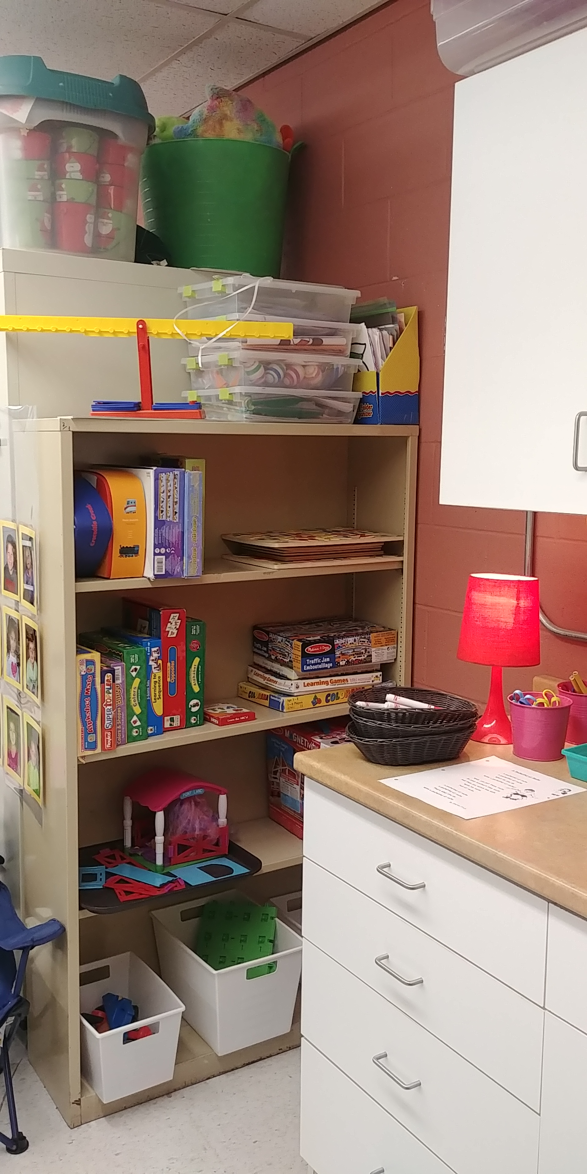
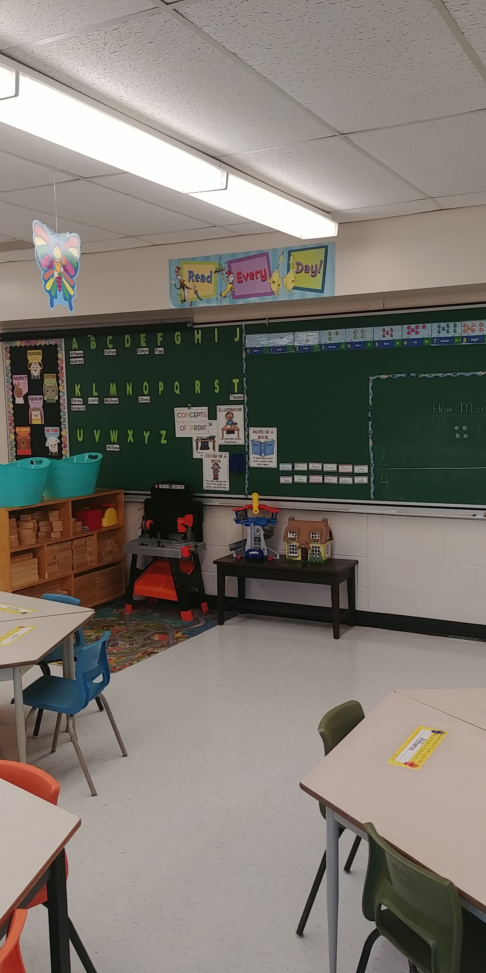
Our Classroom Continued…
Photo 1: Just some of our games and puzzles!
Photo 2: The view from the doorway.
Photo 3: The block center- it’s a real favourite! On the board you can see our Word Wall and our Question of the Day!

Slide 6
What will we learn in KA?
Students will focus on literacy, numeracy and social/emotional learning this year.
Students will spend time each day engaged in purposeful play, both inside the classroom and outside of the school.
Students will take part in weekly physical education, music, art STEM and Indigenous Studies classes.
Students will develop their independence as they take over more and more ownership of our classroom and their choices. They will learn to do many things for themselves, as well as how to be helpers to others.

Slide 7
Class Information
As your child’s teacher, you can communicate with me in multiple ways: 1. In your child’s communication book. This stays in the ‘home baggie’, and I check it when the book is left open to the page with the day’s date. 2. Through email. My email is candice.gallivan@nbed.nb.ca 3. By phone. Call 523-7152 and leave a message with our secretary.
* In all instances I will do my best to get back to you on the same day, but please allow for up to 24 hours.

Slide 8
Daily Schedule
KA
TIME | MONDAY | TUESDAY | WEDNESDAY | THURSDAY | FRIDAY
8:20 – 8:50 | Wellness | Wellness | Wellness | Wellness | Wellness
8:50-9:50 | Literacy | Literacy | Literacy | Literacy | Literacy
9:50-10:05 | Recess | Recess | Recess | Recess | Recess
10:05-11:05 | Math | Math | Math | Math | Math
11:05-11:20 | Math/Lit. | Math/Lit. | Math/Lit. | Math/Lit. | Math/Lit.
11:20-11:50 | Outside | Outside | Outside | Outside | Outside
11:50-12:20 | Lunch | Lunch | Lunch | Lunch | Lunch
12:20-12:50 | Purposeful Play | Purposeful Play | Purposeful Play | Purposeful Play | Purposeful Play
12:50-1:20 | Gym | Purposeful Play | Music | STEM | Indigenous Culture
1:20-1:50 | Purposeful Play | Gym | Purposeful Play | Purposeful Play | Purposeful Play
1:50-2:00 | Dismissal | Dismissal | Dismissal | Dismissal | Dismissal

Slide 9
Class Procedures and Expectations
In KA, we use ‘whole body listening’. This means that we: 1. Listen to others with our ears 2. Look at someone who is speaking with ours eyes 3. Keep our lips zipped when someone else is talking 4. Keep our hands to ourselves 5. Keep our bodies still when we are listening 6. Think about what is being said with our brains 7. Have caring hearts and show respect
123 Magic is a program used in KA to reduce unwanted behaviours and encourage wanted behaviours. When a student receives a #1, they are to stop right away. If they get a #2, they are to stop right away and think about whole-body listening. If they get the #3, they are to take 5 minutes to sit, think and have a chat with the teacher.

Slide 10
Reminders & Extra Info.
Classes start at 8:20 a.m., please do your best to have your child here on time each day.
Students have many opportunities each day to move, play and be kids. Lessons and activities are designed with individual/group needs and students’ interests in mind, as well as best practices for teaching primary-age children.
Reading to children every day is the #1 way to improve vocabulary and early literacy skills. Plus, it is a great way to wind down and get ready for sleep!
Speaking of sleep, children ages 5-13 should get a minimum 9-11 hours of sleep each night. A proper amount of sleep improves physical and mental health, as well as the ability to learn and overall quality of life!

Slide 11
Helping Your Child Succeed in School
Read with your child every night!
2. Talk positively about your child’s teachers and school.
Make sure your child is getting plenty of sleep each night and is ready for school each day.
4. Teach your child to be responsible for their actions.
Stay involved and feel free to contact your child’s teachers with any questions or concerns.
6. Ask your child about school every day and encourage him/her to discuss their day. Search online for ‘open-ended questions to ask young children about school’

Slide 12
Questions?
Please do not hesitate to contact with me if you have any questions or concerns not covered in this presentation.
Thank you!

