Slide 1
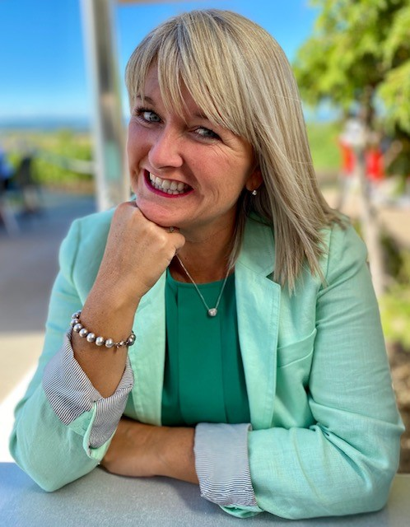
Welcome to Mrs. S. Flanagan’s 2A Class

Slide 2
Take a look inside our grade 2 class…
2Awesome!
Notes:
NOTE: To change images on this slide, select a picture and delete it. Then click the Insert Picture icon in the placeholder to insert your own image.

Slide 3
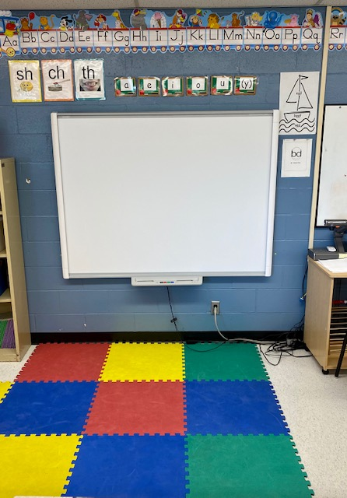
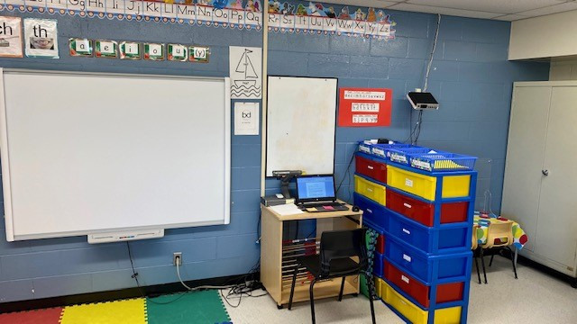
SMART Board Learning Area
Notes:
NOTE: To change images on this slide, select a picture and delete it. Then click the Insert Picture icon in the placeholder to insert your own image.

Slide 4
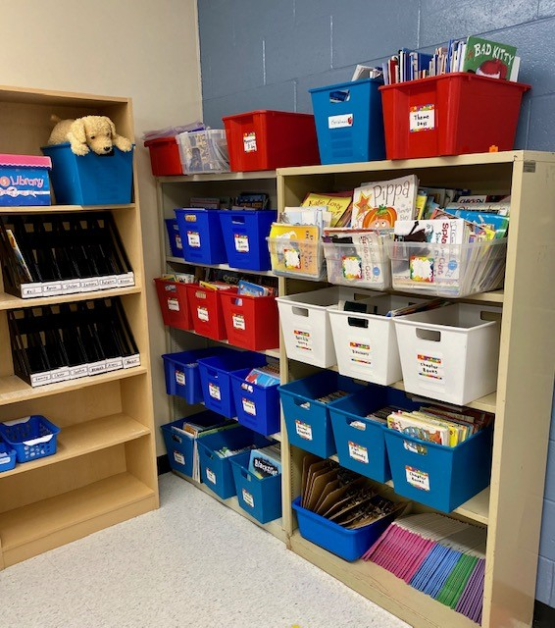
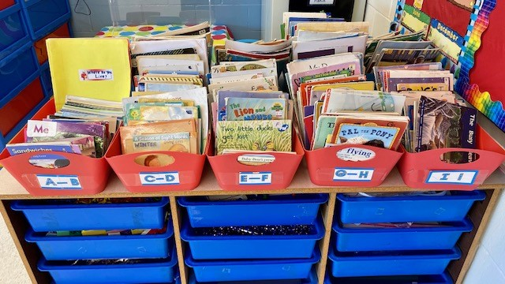
We have books for all different interests!
Notes:
NOTE: To change images on this slide, select a picture and delete it. Then click the Insert Picture icon in the placeholder to insert your own image.

Slide 5
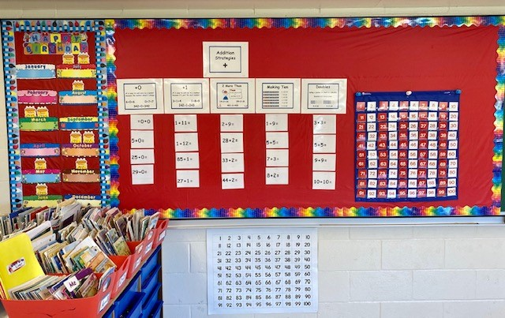
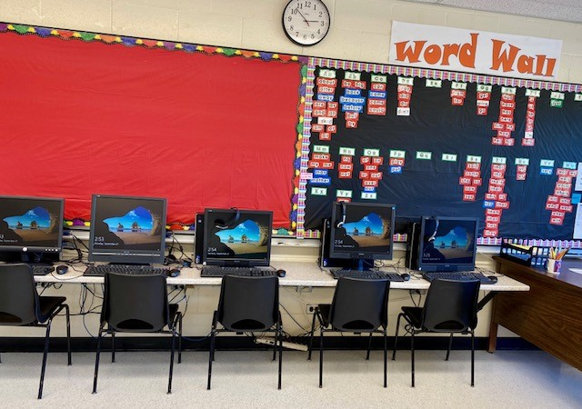
Our class has many available classroom tools such as; a math area, computer area, a word wall calendar area.
Notes:
NOTE: To change images on this slide, select a picture and delete it. Then click the Insert Picture icon in the placeholder to insert your own image.

Slide 6
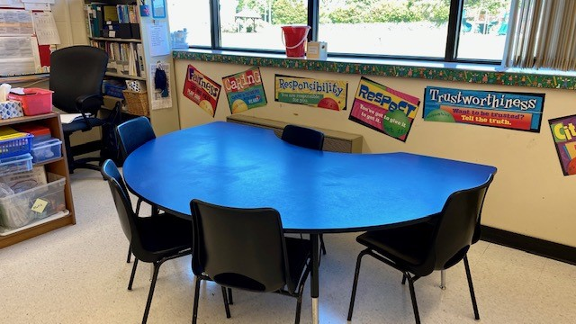
2A also has spaces to work with a partner or in a small group.

Slide 7
Our class schedule looks like this:
7:50 - 8:20: | Students begin to enter- homework bag, lunch, water bottle and begin to play
8:20 - 8:50: | Wellness
8:50 - 9:50: | Literacy
9:50 - 10:05: | Recess (inside)
10:05 - 11:20: | Math (double period)
11:20 - 11:50: | Lunch in classroom
11:50 - 12:20: | Recess (outside)
12:20 - 12:50: | Prepare homework/check agenda and read
12:50 - 1:20: | Literacy
1:20 - 1:50: | Monday - Music (Mrs. Volpe) Tuesday - STEM (Mrs. Rioux) Wednesday - Indigenous Culture (Ms. Sanipass) Thursday - Purposeful Play (Ms. Murphy) & Gym (Mrs. Scully) Friday – Gym (Mrs. Scully)
1:50: | Dismissal

