Slide 1
Welcome to the wonderful world of 1A!

Slide 2
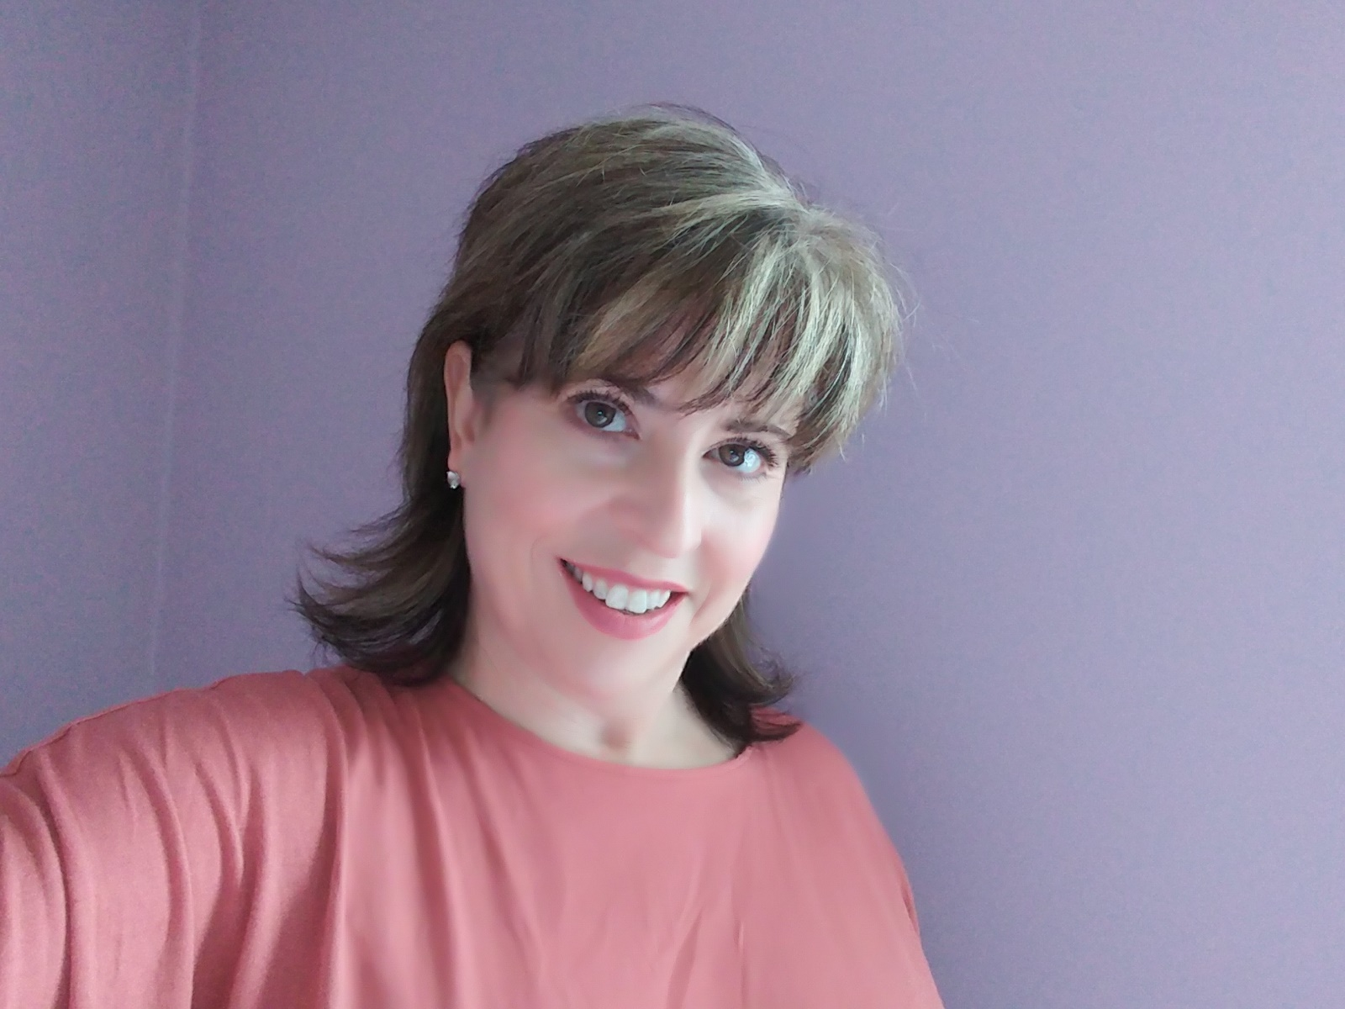
Hello!
I’m Ms. McFadden and I will be teaching 1A this year! ☺

Slide 3
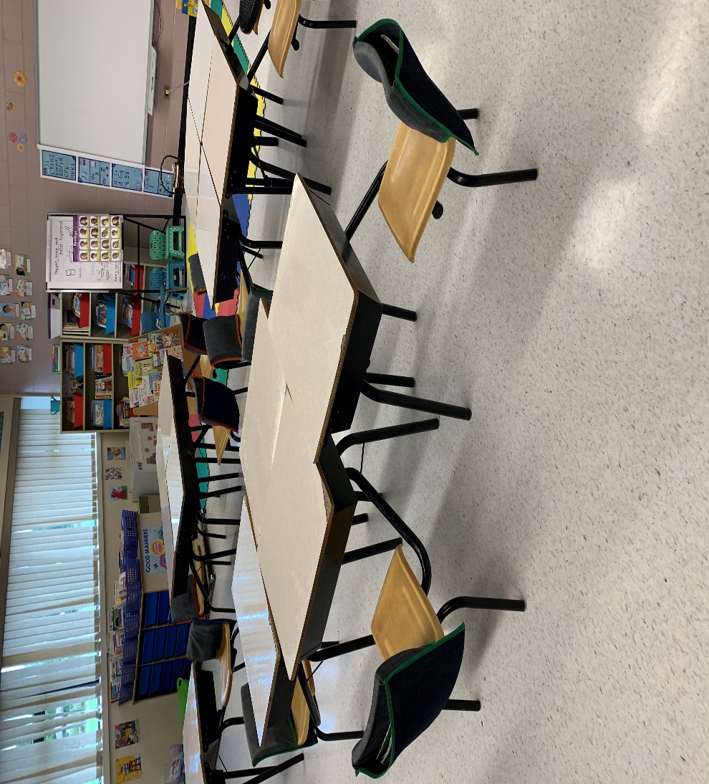
This is where all the magic happens for my 1A students!

Slide 4
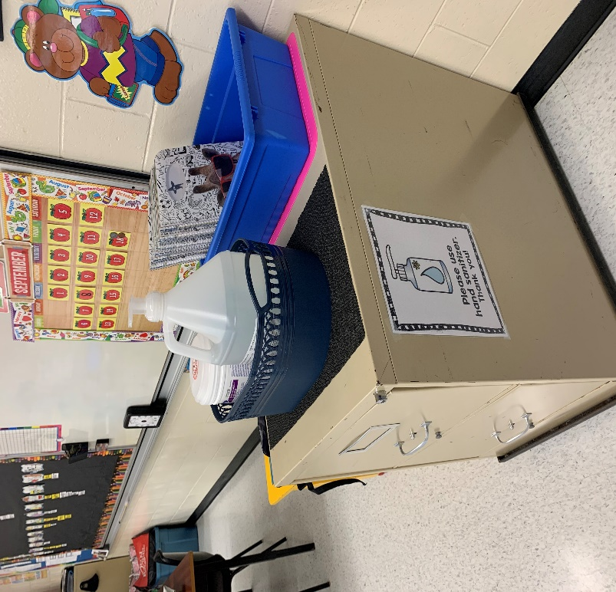
Keeping everyone safe and healthy is going to take extra work so our students must sanitize their hands when they enter the classroom.

Slide 5
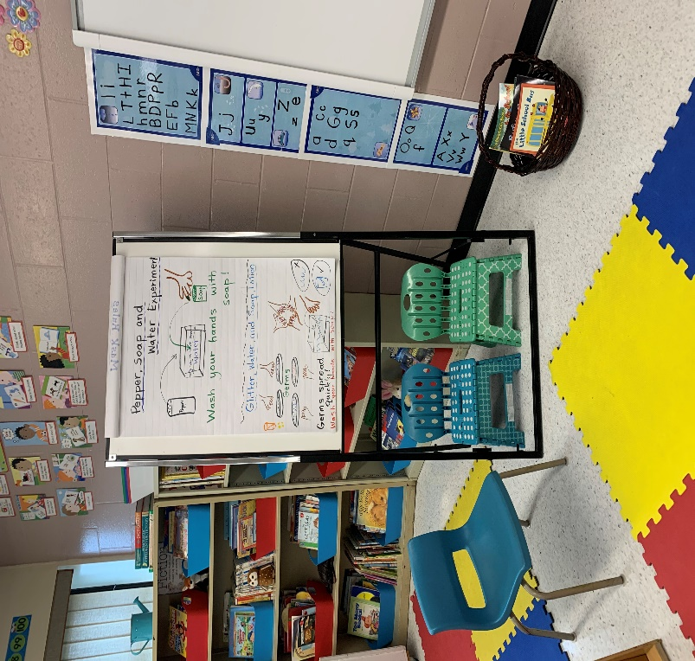
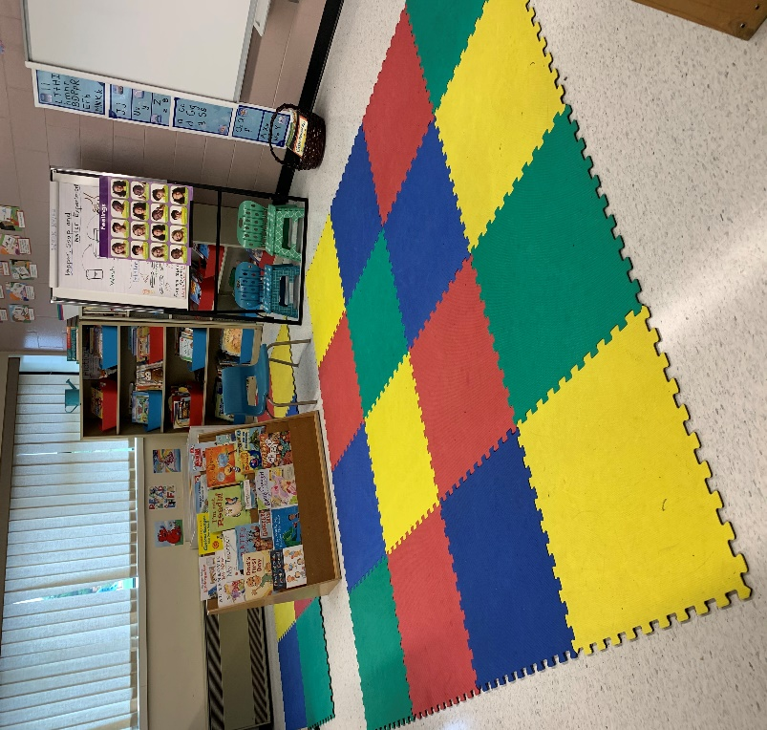
This is where we brainstorm and have read alouds. ☺

Slide 6
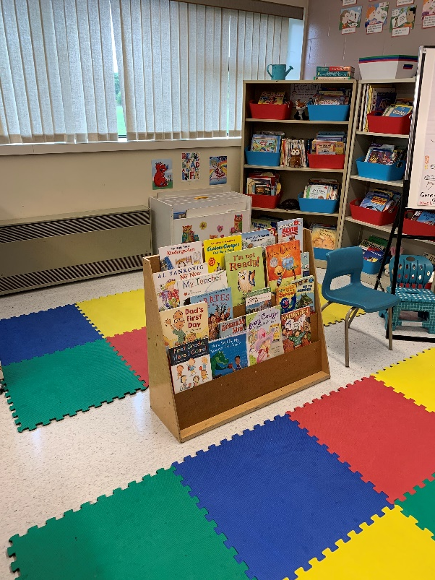
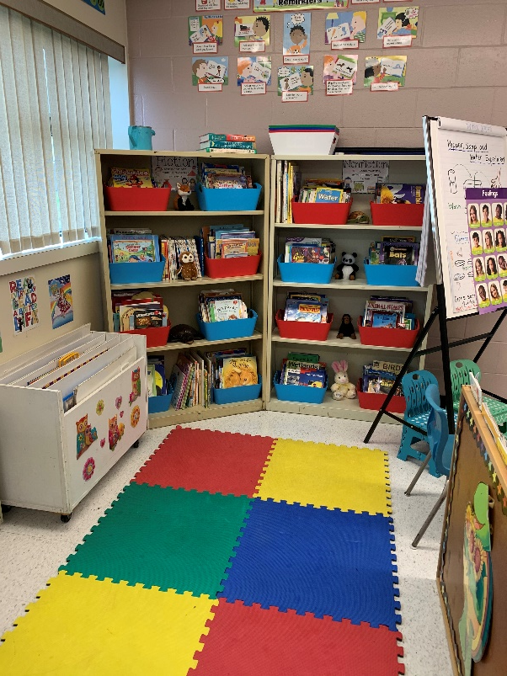
We have a great selection of books to choose from!

Slide 7
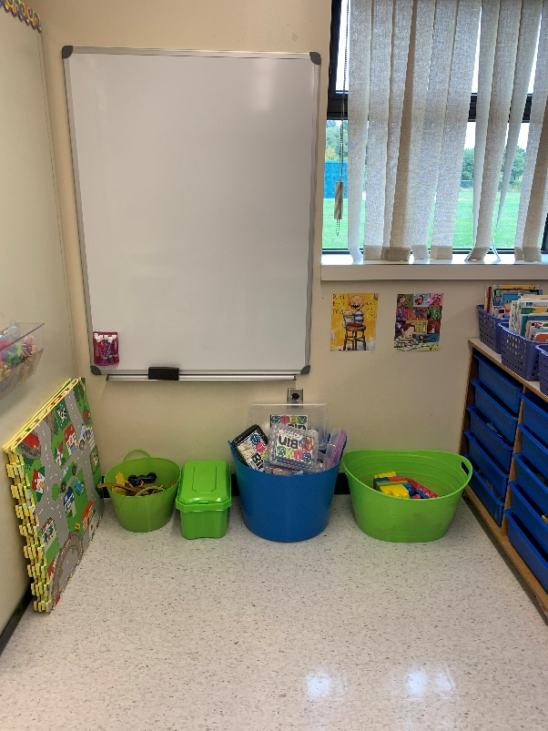
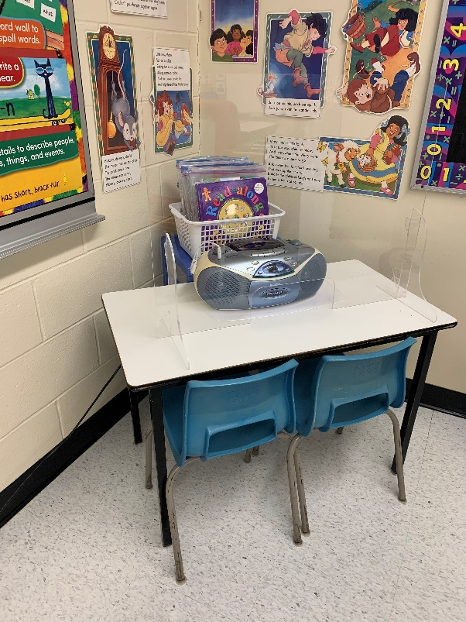
1A plays with bucket toys or they can choose to have a quiet time listening to stories in our listening center. We even have a new white board where students can practice their printing.

Slide 8
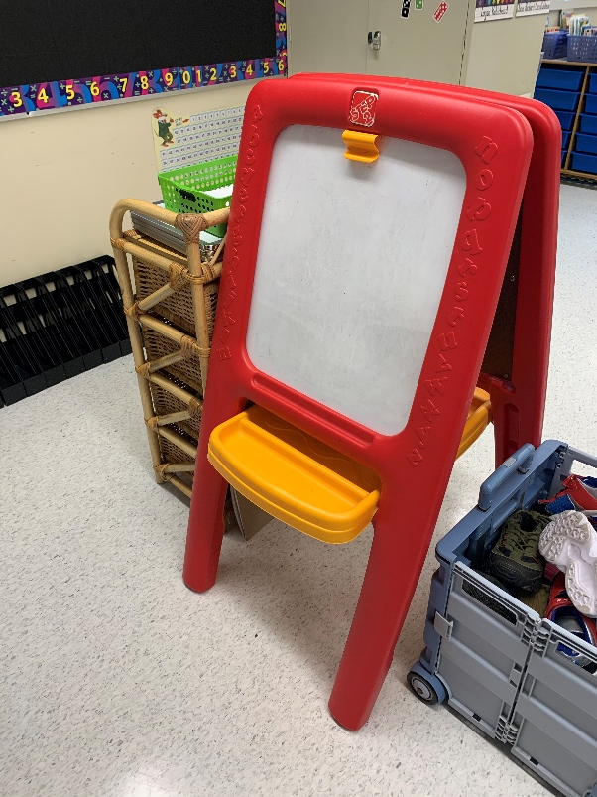
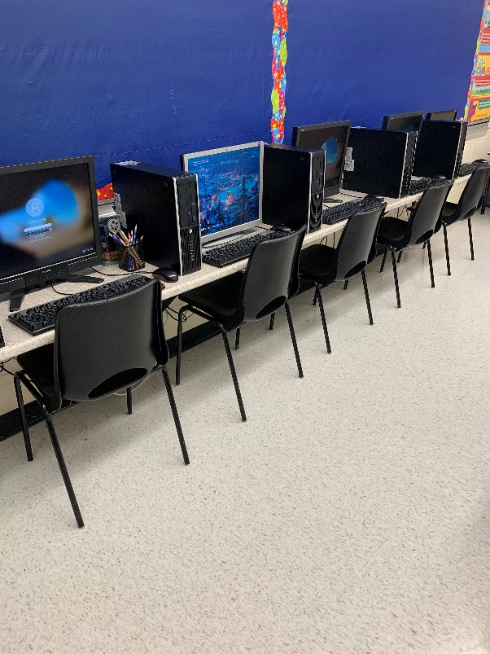
The students love making words at our easel and having time on our computers.

Slide 9
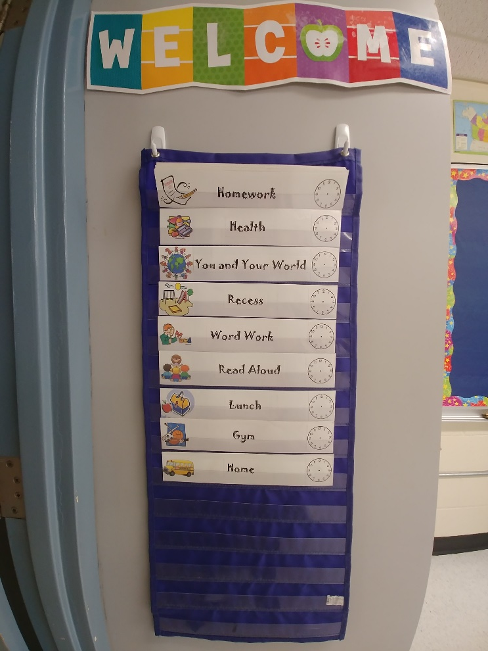
This is a snapshot of our busy schedule! This year we have added three new specialty subjects: Purposeful Play, Aboriginal Studies and STEM. Of course we also have Art, Music and Gym!

Slide 10
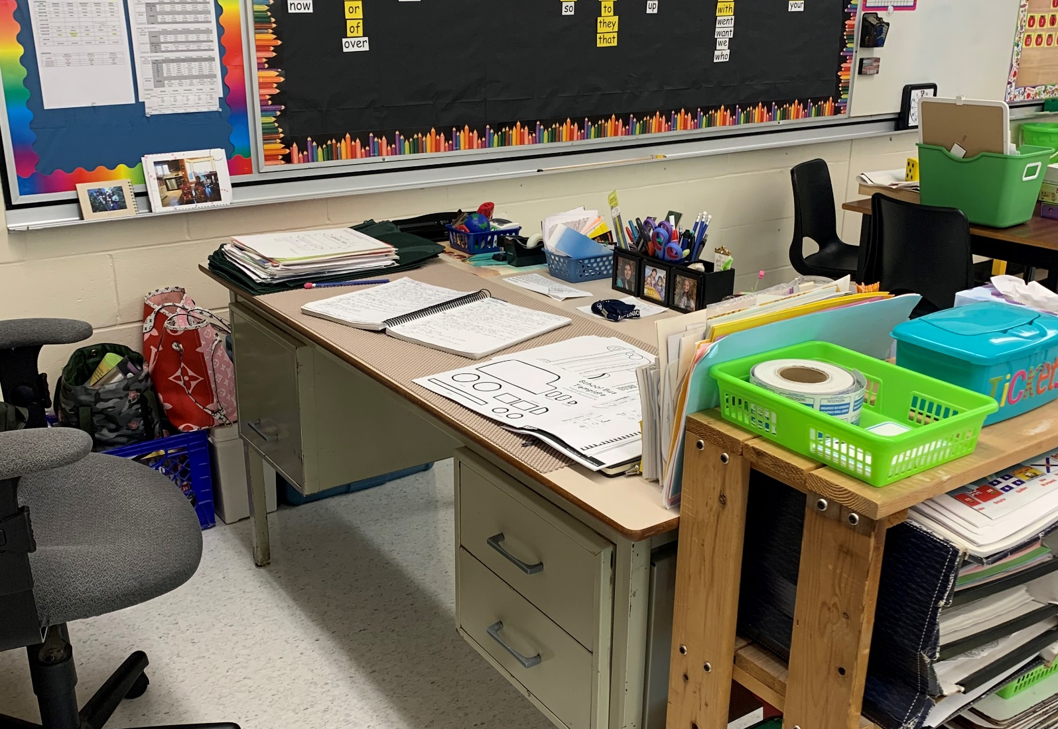
This is my space where I do a lot of planning to create fun lesson plans for my special students!☺

Slide 11
Important Items
If you have not paid your son/daughter’s $40 student fee please do this as soon as possible. Only 5 out of 12 students have paid…. ☹ The money is used to purchase school supplies and extra activities like baking and special crafts.
Also headphones are not provided this year so I ask that you purchase some and send them to school.
If you order your son/daughter a lunch, please indicate in his/her agenda or a note as to what lunch was purchased.
Some homework will be assigned…reading/math.
Please feel free to call me at the school or leave me a message in the agenda if you have any questions or concerns.
I look forward to having a great year with your son/daughter!

